Slide 1
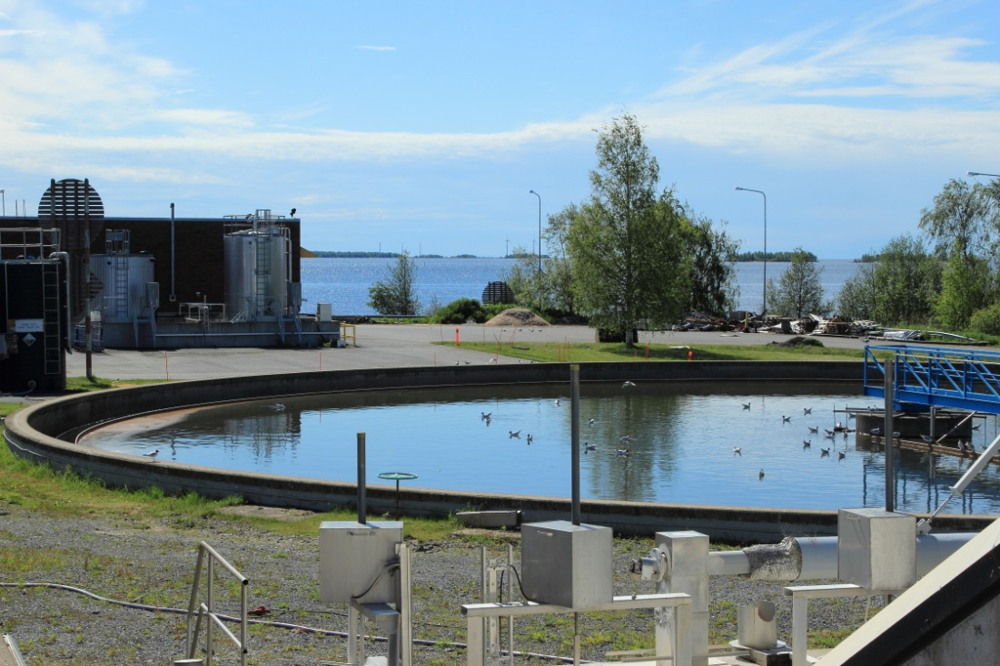
Wastewater contamination scenario
Wastewater Contamination Scenario
Tabletop Exercise
Notes:
The Scenario Presentation is a multimedia presentation used by the facilitator during the tabletop exercise to present the material in the Situation Manual (SitMan). The Scenario Presentation is put together from and follows the same order as the SitMan. Most users will find it easier to develop the Scenario Presentation after they have finalized the SitMan.
All of the slides presented here may be modified as needed. For example, an Exercise Development Team (EDT) may decide not to include all or part of the slides presented here since the same information is already available to participants through their SitMan.
Facilitators are encouraged to use this “notes” section on each slide to incorporate additional material, such as follow-up questions or comments.

Slide 2
Tabletop Exercise
Welcome and introductions
Discuss agenda for the day
Review administrative details
Start the exercise

Slide 3
Welcome and Introductions
Name
Organization
Emergency response experience

Slide 4
Agenda
Review exercise materials and rules
Review scenario(s)
Break
Facilitated discussion period
Action planning session (“hot wash”)
Review and conclusion
Closing comments

Slide 5
Administrative Details
Location of emergency exits
Location of restrooms
Cell phone and pager management
Logging your time to fulfill training requirements
Sign-in sheet and participant evaluation form

Slide 6
Exercise Benefits:
Increase readiness in the event of an actual emergency
Provide a means to assess effectiveness of response plans and response capabilities
Serve as a training tool for response personnel and their involvement with other response agencies
Provide an opportunity to practice skills and improve individual performance in a non-threatening environment

Slide 7
Exercise Benefits: (cont.)
Require participants to network with each other and pre-plan decisions on resources
Identify planning conflicts or gaps
Identify resource needs and opportunities for sharing of resources
Clarify internal and external roles and responsibilities

Slide 8
Exercise Objectives:
At the conclusion of this exercise, participants should be able to do the following:
Define or refine participants’ roles and responsibilities for managing the consequences of a wastewater hazardous material contamination incident, which should be reflected in their plans, policies and procedures and other preparedness elements currently in place or under development
Build relationships between utilities and stakeholders
Notes:
8

Slide 9
Exercise Objectives: (cont.)
Determine neighboring utility water infrastructure capabilities and needs
Identify other needed enhancements related to training and exercises and other preparedness elements currently in place or under development
This session will not be a success unless you as a participant go back to your office and follow through
Notes:
9

Slide 10
Roles and Responsibilities:
Players respond to the situation presented based on expert knowledge of response procedures, current plans and procedures and insights derived from training and experience
Observers observe the exercise but do not participate in the facilitated discussion period
Facilitators lead the exercise by presenting the scenario narrative and facilitating the discussion period and “hot wash” (Action planning session or review session)
Evaluators monitor the exercise, track accomplishments according to objectives and may ask questions

Slide 11
Exercise Rules:
This exercise will be held in an open, low-stress, no-fault environment − varying viewpoints, even disagreements, are expected
Respond to the scenario using your knowledge of current plans and capabilities (i.e., you may use only existing assets) and insights derived from your training
Decisions are not precedent setting and may not reflect your organization’s final position on a given issue − this exercise is an opportunity to discuss and present multiple options and possible solutions

Slide 12
Exercise Rules: (cont.)
Issue identification is not as valuable as suggestions and recommended actions that could improve [prevention, protection, mitigation, response or recovery] efforts − problem-solving efforts should be the focus
Assume there will be cooperation and support from other responders and agencies
The basis for discussion consists of the scenario narrative and modules, your experience, your understanding of your Emergency Response Plan (ERP), your intuition and other utility resources included as part of this material or that you brought with you
Treat the scenario as if it will affect your area

Slide 13
Action planning session
Action Planning Session:
Following the facilitated discussion period, the facilitator will lead an Action Planning Session, also known as a “hot wash”
Participants are encouraged to identify, discuss and prioritize next steps, actions, tasks and other follow-up activities
Identify additional collaborators if needed
Schedule a follow-up meeting

Slide 14
Cybersecurity scenario
Wastewaster Contamination Scenario

Slide 15
Background
It is spring and rain has fallen on and off for several weeks
Over that timeframe, the wastewater utility has noted an increase in flows due to infiltration and inflows into the collection system
The amounts are noteworthy, but within normal ranges for this time of year

Slide 16
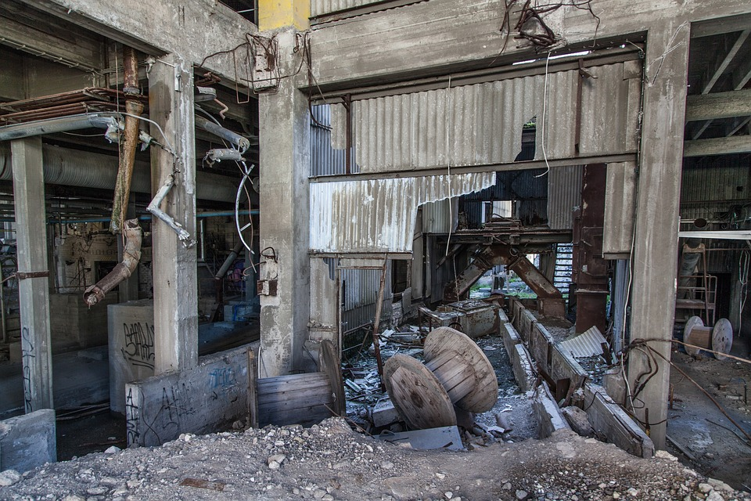
Module 1 – April 24 Threat of Contamination is Observed

Slide 17
Module 1 – April 24, 0700 hrs
State regulatory inspectors begin inspecting hazardous materials facilities in the general area
They locate an illegal chroming operation in a warehouse
The illegal operators, hearing that spot inspections were occurring in the area, ran tubing into the sewer and dumped all the waste before abandoning the site
Notes:
17

Slide 18
Key Issues – Module 1
The community has a tertiary wastewater treatment plant − the treatment process begins with primary sedimentation, followed by secondary treatment using activated sludge and tertiary treatment with nitrogen removal prior to discharge
The process of chroming involves the use of many hazardous chemicals, including strong acids and chromium, a known human carcinogen
Notes:
Based on the information provided, encourage players to participate in a discussion concerning the issues raised in Module 1. Identify any critical issues, decisions, requirements or questions that should be addressed at this time.
The following questions are provided as suggested subjects that you may wish to address as the discussion progresses. These questions are not meant to constitute a definitive list of concerns to be addressed, nor is there a requirement to address every question.
[How and by whom would operators and managers at your facility be notified of this incident?]
[What procedures have been developed at your utility to respond to chemical contamination in wastewater influent?]
[What, if any, preemptive measures would your wastewater utility take to respond to the threat of influent contamination?]
[How will your utility determine whether contamination has reached the facility?]
[Are there any initial notifications to external response agencies that you would make?]

Slide 19
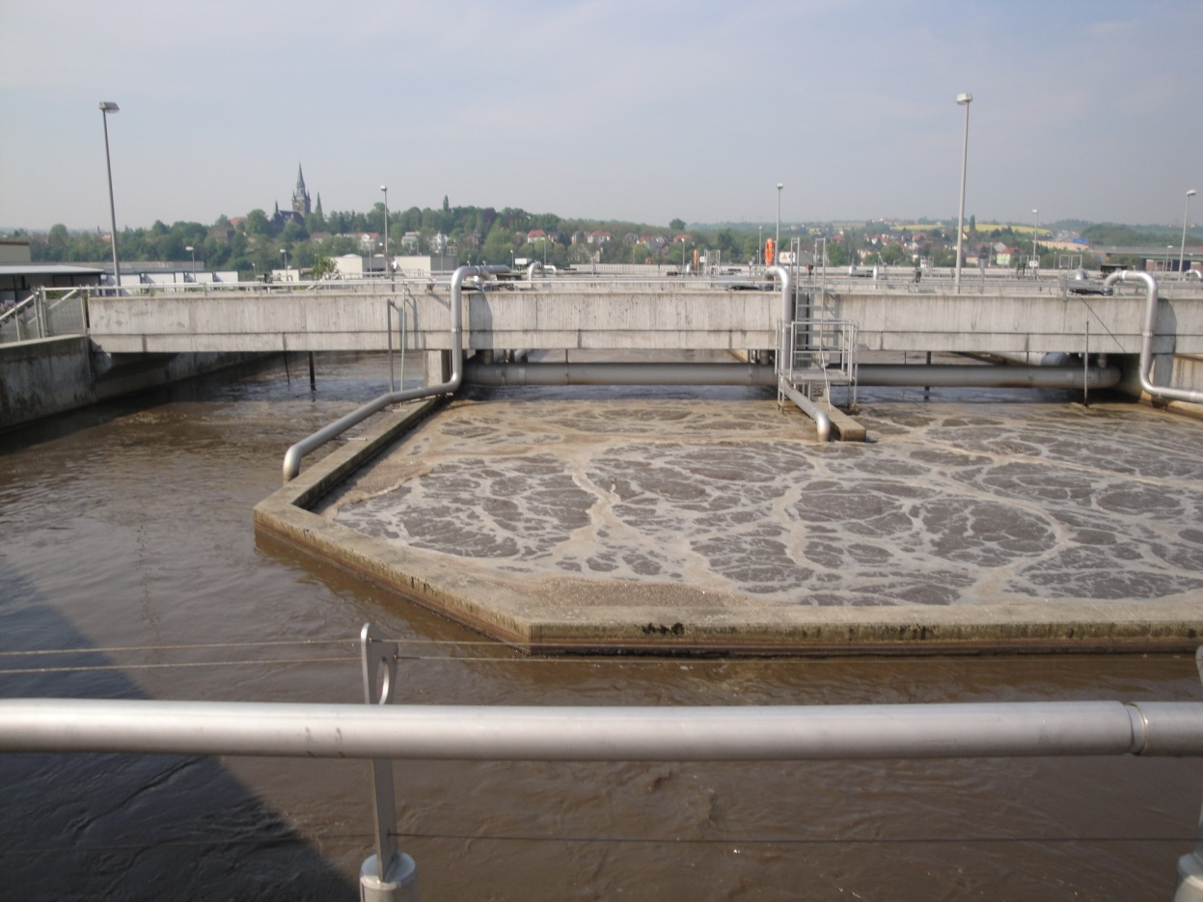
Module 2 – April 25 Contamination Impacts Treatment Process

Slide 20
Module 2 – April 25, 0700 hrs
The wastewater utility operators are alarmed by abrupt changes in the color and smell of the treatment process flows
Simultaneously, calls from local residents regarding a significant amount of dead fish downstream of the utility outfall are jamming inbound lines at the city and the wastewater utility’s offices

Slide 21
Module 2 – April 25, 0700 hrs (cont.)
Concerned by observed changes, reduced process efficacy and the reported fish kill, the wastewater utility requests support from area laboratories to analyze influent and effluent samples, as well as samples from the collection system

Slide 22
Module 2 – April 25, 0700 hrs (cont.)
Activated sludge floc size and structure characterization seem to show reduced filament abundance, causing the appearance of pin-point flocs and free-dispersed bacteria
As a result of dispersed growth, effluent quality deteriorated since significant amounts of suspended solids escaped with the effluent

Slide 23
Key Issues – Module 2 (cont.)
The nitrification process has been significantly inhibited − ammonia removal has decreased by up to 75 percent
The wastewater utility is concerned that effluent released from the system has already exceeded allowable limits
Utility personnel are also concerned about their personal safety when working around the potentially contaminated wastewater

Slide 24
Key Issues – Module 2 (cont.)
Utility personnel begin reviewing the Water Contaminant Information Tool (WCIT) to gather more information on the potential contaminants
Notes:
Based on the information provided, encourage players to participate in a discussion concerning the issues raised in Module 2. Identify any critical issues, decisions, requirements or questions that should be addressed at this time.
The following questions are provided as suggested subjects that you may wish to address as the discussion progresses. These questions are not meant to constitute a definitive list of concerns to be addressed, nor is there a requirement to address every question.
[What immediate operational actions would your utility take in response to this severe contamination incident?]
[What safety actions (e.g., requiring personal protective equipment) should your utility take to ensure that additional staff is not exposed to the contaminants during routine operations?]

Slide 25
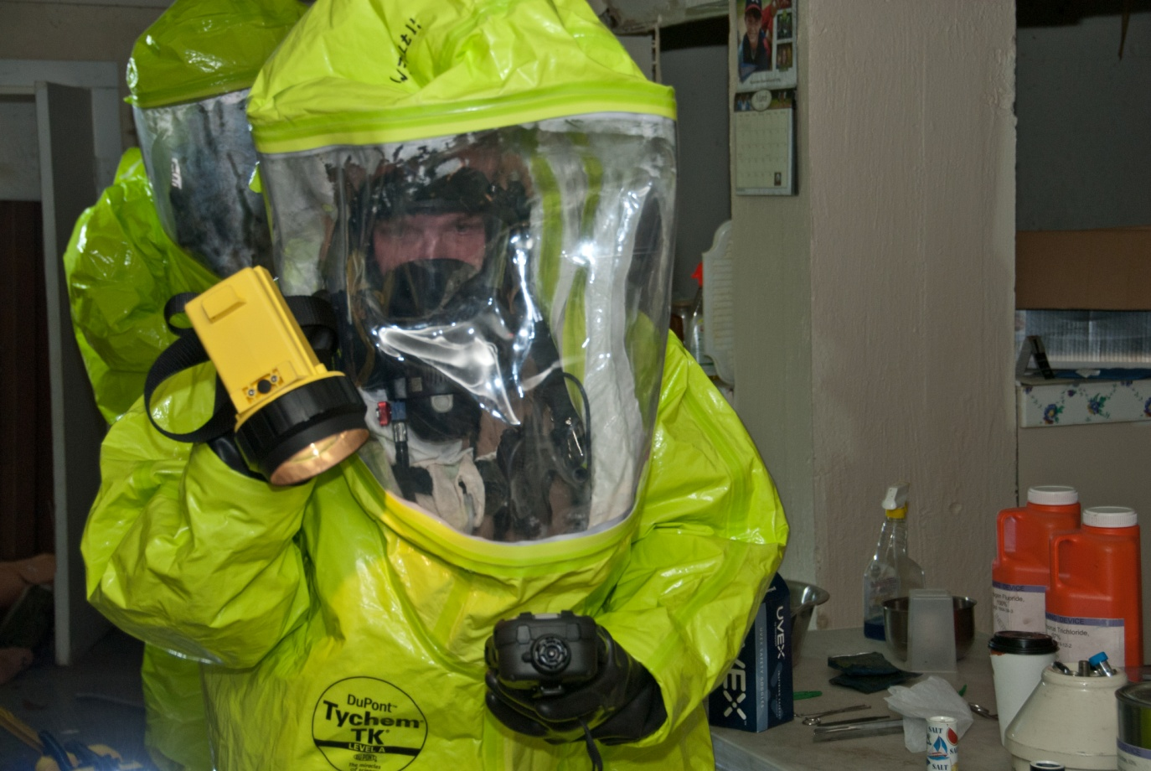
Module 3 – April 25 Response to Contamination Begins

Slide 26
Module 3 – April 25, 1200 hrs
The state mobilizes hazardous materials experts and notifies regional federal response teams
The local emergency management office calls an emergency meeting
The wastewater utility is concerned about staying within permit parameters
It is likely that the contaminant has affected the wastewater plant’s biomass, contaminated the residuals and impacted the downstream ecosystem

Slide 27
Key Issues – Module 3
The utility and state experts are unsure whether all the hazardous material has reached the treatment system
Drinking water utilities and public safety officials downstream of the affected utility are calling to determine whether downstream utilities may also be at risk
Cost estimates for remediation and restoration of the wastewater plant alone may exceed several million dollars
Notes:
Based on the information provided, encourage players to participate in a discussion concerning the issues raised in Module 3. Identify any critical issues, decisions, requirements or questions that should be addressed at this time.
The following questions are provided as suggested subjects that you may wish to address as the discussion progresses. These questions are not meant to constitute a definitive list of concerns to be addressed, nor is there a requirement to address every question.
[What procedures have been developed by your utility to address continuity of operations?]
[What procedures have been developed for conducting sampling and analysis to confirm contamination?]
[What laboratory capabilities will be required in response to this incident? How will the laboratories you work with be impacted by the increased demand for testing resulting from this incident?]
[What local and state agencies or organizations would be helpful in response to and recovery from this type of incident, and how will you coordinate with them?]
[What additional resources (e.g., staff, heavy equipment and generators) would your utility need to repair damage and restore service? Where will they come from?]

Slide 28
Action planning session post exercise
Action Planning Session
Post-Exercise “Hot Wash”

Slide 29
Review of exercise objectives
Review of Exercise Objectives
Explore and address cybersecurity challenges
Define or refine participants’ roles and responsibilities for managing the consequences of a cybersecurity incident, which should be reflected in their plans, policies and procedures and other preparedness elements currently in place or under development
Build relationships between utilities and stakeholders
Increase awareness of the damage that can be caused by a cybersecurity incident on a business or control system
Identify other needed enhancements related to training and exercises and other preparedness elements currently in place or under development
Notes:
Discuss each objective and corresponding outcome.

Slide 30
conclusion
Conclusion
Please turn in your notes from the Action Planning Session, your participant evaluation form and any additional comments you wish to share
This information will be used to develop an After Action Report and Improvement Plan

Slide 31
Closing remarks thank you for participating
Closing Remarks
Thank you for participating

