Slide 1
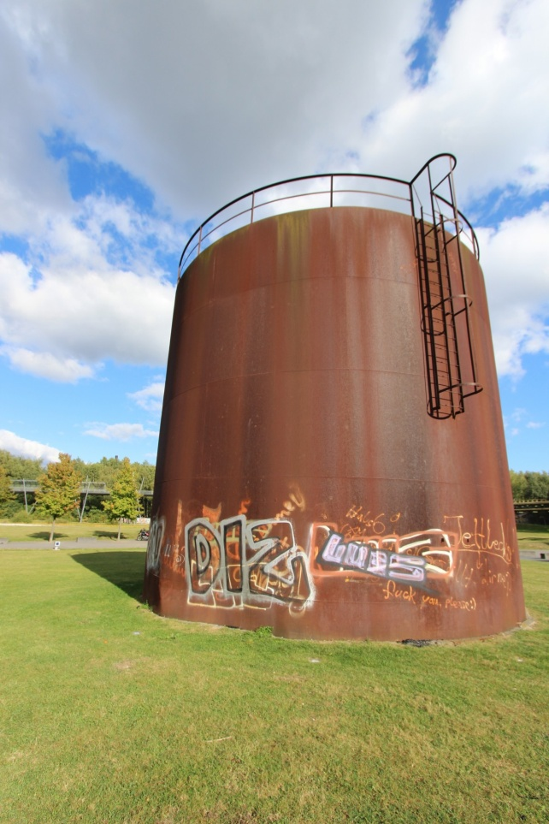
Vandalism scenario
Vandalism Scenario
Tabletop Exercise
Notes:
The Scenario Presentation is a multimedia presentation used by the facilitator during the tabletop exercise to present the material in the Situation Manual (SitMan). The Scenario Presentation is put together from and follows the same order as the SitMan. Most users will find it easier to develop the Scenario Presentation after they have finalized the SitMan.
All of the slides presented here may be modified as needed. For example, an Exercise Development Team (EDT) may decide not to include all or part of the slides presented here since the same information is already available to participants through their SitMan.
Facilitators are encouraged to use this “notes” section on each slide to incorporate additional material, such as follow-up questions or comments.

Slide 2
Tabletop Exercise
Welcome and introductions
Discuss agenda for the day
Review administrative details
Start the exercise

Slide 3
Welcome and Introductions
Name
Organization
Emergency response experience

Slide 4
Agenda
Review exercise materials and rules
Review scenario(s)
Break
Facilitated discussion period
Action planning session (“hot wash”)
Review and conclusion
Closing comments

Slide 5
Administrative Details
Location of emergency exits
Location of restrooms
Cell phone and pager management
Logging your time to fulfill training requirements
Sign-in sheet and participant evaluation form

Slide 6
Exercise Benefits:
Increase readiness in the event of an actual emergency
Provide a means to assess effectiveness of response plans and response capabilities
Serve as a training tool for response personnel and their involvement with other response agencies
Provide an opportunity to practice skills and improve individual performance in a non-threatening environment

Slide 7
Exercise Benefits: (cont.)
Require participants to network with each other and pre-plan decisions on resources
Identify planning conflicts or gaps
Identify resource needs and opportunities for sharing of resources
Clarify internal and external roles and responsibilities

Slide 8
Exercise Objectives:
At the conclusion of this exercise, participants should be able to do the following:
Define or refine participants’ roles and responsibilities for managing the consequences of a vandalism incident, which should be reflected in their plans, policies, procedures and other preparedness elements currently in place or under development
Build relationships between utilities and stakeholders
Notes:
8

Slide 9
Exercise Objectives: (cont.)
Determine neighboring utility water infrastructure capabilities and needs
Identify other needed enhancements related to training and exercises and other preparedness elements currently in place or under development
This session will not be a success unless you as a participant go back to your office and follow through
Notes:
9

Slide 10
Roles and Responsibilities:
Players respond to the situation presented based on expert knowledge of response procedures, current plans and procedures and insights derived from training and experience
Observers observe the exercise but do not participate in the facilitated discussion period
Facilitators lead the exercise by presenting the scenario narrative and facilitating the discussion period and “hot wash” (Action planning session or review session)
Evaluators monitor the exercise, track accomplishments according to objectives and may ask questions

Slide 11
Exercise Rules:
This exercise will be held in an open, low-stress, no-fault environment − varying viewpoints, even disagreements, are expected
Respond to the scenario using your knowledge of current plans and capabilities (i.e., you may use only existing assets) and insights derived from your training
Decisions are not precedent setting and may not reflect your organization’s final position on a given issue − this exercise is an opportunity to discuss and present multiple options and possible solutions

Slide 12
Exercise Rules: (cont.)
Issue identification is not as valuable as suggestions and recommended actions that could improve [prevention, protection, mitigation, response or recovery] efforts − problem-solving efforts should be the focus
Assume there will be cooperation and support from other responders and agencies
The basis for discussion consists of the scenario narrative and modules, your experience, your understanding of your Emergency Response Plan (ERP), your intuition and other utility resources included as part of this material or that you brought with you
Treat the scenario as if it will affect your area

Slide 13
Action planning session
Action Planning Session:
Following the facilitated discussion period, the facilitator will lead an Action Planning Session, also known as a “hot wash”
Participants are encouraged to identify, discuss and prioritize next steps, actions, tasks and other follow-up activities
Identify additional collaborators if needed
Schedule a follow-up meeting

Slide 14
Cybersecurity scenario
Vandalism Scenario

Slide 15
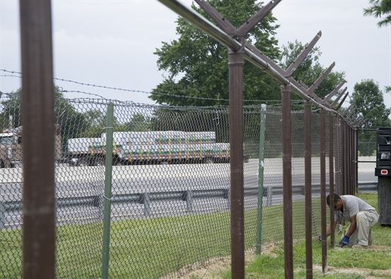
Module 1 – January 24 Vandalism is Discovered

Slide 16
Module 1 – January 24, 0845 hrs
During a routine inspection, water utility personnel discover a break-in at a 1.3-million gallon, elevated water storage tank − the 10-foot chain link fence topped with barbed wire has been cut
The door to the tank’s control room has been pried open and the door knob removed
All wiring for the alarm system has been ripped out of the control panel and cut − copper wiring for the main control panel has been cut and is missing along with copper piping
Notes:
16

Slide 17
Module 1 – January 24, 0845 hrs (cont.)
A 5-gallon bucket with a lid labeled “decorative and protective coating” is in a black trash bag just adjacent to the tank’s control room
There is a chemical odor coming from the bucket
The security gate at the base of the tank’s ladder, which is 15 feet above the ground surface, has been broken and is hanging by one hinge
A step ladder was used to reach the security gate
On top of the tank, the vent screening is missing
Notes:
17

Slide 18
Module 1 – January 24, 0845 hrs (cont.)
Meanwhile, a chemical delivery vendor noted that the lock on the rear access gate to the wastewater treatment plant has been cut
No fresh tire tracks could be found in the unpaved driveway leading to the back of the plant
Several security lights around the wastewater plant headworks have been broken
A front-end loader missing from the back lot is found smashed into the main electrical service − power has been knocked out to the plant, and alarms are sounding
Notes:
18

Slide 19
Key Issues – Module 1
It is unknown whether the stored drinking water has been contaminated, and if so, with what, and what specific tests will be required to determine its safety
It is difficult to determine when the break-ins happened, and if any potentially contaminated potable water was inadvertently pumped to customers
The alarm panel at the drinking water utility is not functioning nor is a motor control integral to the safe operation of the adjacent pump station

Slide 20
Key Issues – Module 1 (cont.)
Local police are asking when the utilities will release information to the news media and public
The loss of power has crippled the entire wastewater treatment plant
Overflowing wastewater is running into a shallow drainage swale which discharges to an environmentally sensitive area
Police and fire personnel have responded to the wastewater utility and have called in the local electrical utility to assess the damage − state environmental protection staff has been alerted to the potential contamination in the sensitive environmental area

Slide 21
Key Issues, continued – Module 1
Local police also call the FBI
While utility management still controls both facilities’ operations, there will need to be cooperation with evidence collection teams from both law enforcement and the U.S. Environmental Protection Agency
Notes:
Based on the information provided, encourage players to participate in a discussion concerning the issues raised in Module 1. Identify any critical issues, decisions, requirements or questions that should be addressed at this time.
The following questions are provided as suggested subjects that you may wish to address as the discussion progresses. These questions are not meant to constitute a definitive list of concerns to be addressed, nor is there a requirement to address every question.
[With whom do you coordinate at the local and state levels at the initiation of incidents like this?]
[What procedures have been developed to assess the incidents and take initial actions to support the responses?]
[Does your utility have a routine facility inspection program with written logs maintained by staff? What other physical security measures or processes might yield more information about the incidents?]
[How will communications be handled to internal staff, to the public and to officials?]
[How would you involve law enforcement, and how would your utility’s staff cooperate and assist law enforcement efforts?]
[What procedures have been developed for conducting sampling and analysis to confirm contamination?]
[What laboratory capabilities will be required in response to this incident? How will the laboratories you work with be impacted by the increased demand for testing resulting from this incident?]
[How do you determine if an advisory or public notification (such as boil water or do not use) needs to be issued for this incident? How would this occur without power and if normal communication media such as TV and radio outlets are unavailable? What alternative resources could be available to issue an advisory?]
[How will response efforts be impacted by the loss of power at the wastewater utility?]
[What measures does your wastewater utility have in place to prevent environmental contamination from a wastewater overflow?]
[How would conflicts between your utilities’ response goals and priorities and the evidentiary goals and priorities of law enforcement agencies be resolved?]
[What inspection or surveillance programs are in place to detect any physical security breaches related to utility equipment, such as pump houses or stations and either the distribution or collection system? Does your utility have a “citizens watch network” or “water watchers” in place within the served community?]

Slide 22
Action planning session post exercise
Action Planning Session
Post-Exercise “Hot Wash”

Slide 23
Review of exercise objectives
Review of Exercise Objectives
Explore and address cybersecurity challenges
Define or refine participants’ roles and responsibilities for managing the consequences of a cybersecurity incident, which should be reflected in their plans, policies and procedures and other preparedness elements currently in place or under development
Build relationships between utilities and stakeholders
Increase awareness of the damage that can be caused by a cybersecurity incident on a business or control system
Identify other needed enhancements related to training and exercises and other preparedness elements currently in place or under development
Notes:
Discuss each objective and corresponding outcome.

Slide 24
conclusion
Conclusion
Please turn in your notes from the Action Planning Session, your participant evaluation form and any additional comments you wish to share
This information will be used to develop an After Action Report and Improvement Plan

Slide 25
Closing remarks thank you for participating
Closing Remarks
Thank you for participating

