Slide 1
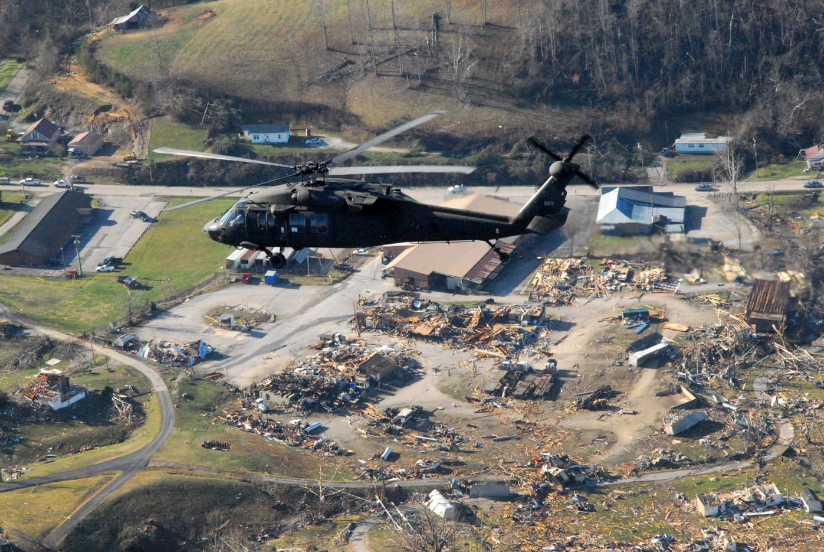
Tornado scenario
Tornado Scenario
Tabletop Exercise
Notes:
The Scenario Presentation is a multimedia presentation used by the facilitator during the tabletop exercise to present the material in the Situation Manual (SitMan). The Scenario Presentation is put together from and follows the same order as the SitMan. Most users will find it easier to develop the Scenario Presentation after they have finalized the SitMan.
All of the slides presented here may be modified as needed. For example, an Exercise Development Team (EDT) may decide not to include all or part of the slides presented here since the same information is already available to participants through their SitMan.
Facilitators are encouraged to use this “notes” section on each slide to incorporate additional material, such as follow-up questions or comments.

Slide 2
Tabletop Exercise
Welcome and introductions
Discuss agenda for the day
Review administrative details
Start the exercise

Slide 3
Welcome and Introductions
Name
Organization
Emergency response experience

Slide 4
Agenda
Review exercise materials and rules
Review scenario(s)
Break
Facilitated discussion period
Action planning session (“hot wash”)
Review and conclusion
Closing comments

Slide 5
Administrative Details
Location of emergency exits
Location of restrooms
Cell phone and pager management
Logging your time to fulfill training requirements
Sign-in sheet and participant evaluation form

Slide 6
Exercise Benefits:
Increase readiness in the event of an actual emergency
Provide a means to assess effectiveness of response plans and response capabilities
Serve as a training tool for response personnel and their involvement with other response agencies
Provide an opportunity to practice skills and improve individual performance in a non-threatening environment

Slide 7
Exercise Benefits: (cont.)
Require participants to network with each other and pre-plan decisions on resources
Identify planning conflicts or gaps
Identify resource needs and opportunities for sharing of resources
Clarify internal and external roles and responsibilities

Slide 8
Exercise Objectives:
At the conclusion of this exercise, participants should be able to do the following:
Define or refine participants’ roles and responsibilities for managing the consequences of a tornado incident, which should be reflected in their plans, policies and procedures and other preparedness elements currently in place or under development
Build relationships between utilities and stakeholders
Notes:
8

Slide 9
Exercise Objectives: (cont.)
Determine neighboring utility water infrastructure capabilities and needs
Identify other needed enhancements related to training and exercises and other preparedness elements currently in place or under development
This session will not be a success unless you as a participant go back to your office and follow through
Notes:
9

Slide 10
Roles and Responsibilities:
Players respond to the situation presented based on expert knowledge of response procedures, current plans and procedures and insights derived from training and experience
Observers observe the exercise but do not participate in the facilitated discussion period
Facilitators lead the exercise by presenting the scenario narrative and facilitating the discussion period and “hot wash” (Action planning session or review session)
Evaluators monitor the exercise, track accomplishments according to objectives and may ask questions

Slide 11
Exercise Rules:
This exercise will be held in an open, low-stress, no-fault environment − varying viewpoints, even disagreements, are expected
Respond to the scenario using your knowledge of current plans and capabilities (i.e., you may use only existing assets) and insights derived from your training
Decisions are not precedent setting and may not reflect your organization’s final position on a given issue − this exercise is an opportunity to discuss and present multiple options and possible solutions

Slide 12
Exercise Rules: (cont.)
Issue identification is not as valuable as suggestions and recommended actions that could improve [prevention, protection, mitigation, response or recovery] efforts − problem-solving efforts should be the focus
Assume there will be cooperation and support from other responders and agencies
The basis for discussion consists of the scenario narrative and modules, your experience, your understanding of your Emergency Response Plan (ERP), your intuition and other utility resources included as part of this material or that you brought with you
Treat the scenario as if it will affect your area

Slide 13
Action planning session
Action Planning Session:
Following the facilitated discussion period, the facilitator will lead an Action Planning Session, also known as a “hot wash”
Participants are encouraged to identify, discuss and prioritize next steps, actions, tasks and other follow-up activities
Identify additional collaborators if needed
Schedule a follow-up meeting

Slide 14
Cybersecurity scenario
Tornado Scenario

Slide 15
Background
It is Tuesday in the latter part of spring − temperatures are warm and skies are clear except to the south where there are some dark clouds on the horizon
Operations at the drinking water utility are normal, with field personnel out making inspections and repairs and a supplier on site delivering chemicals to the drinking water and wastewater utility plants
Operations at the wastewater utility are also routine.

Slide 16
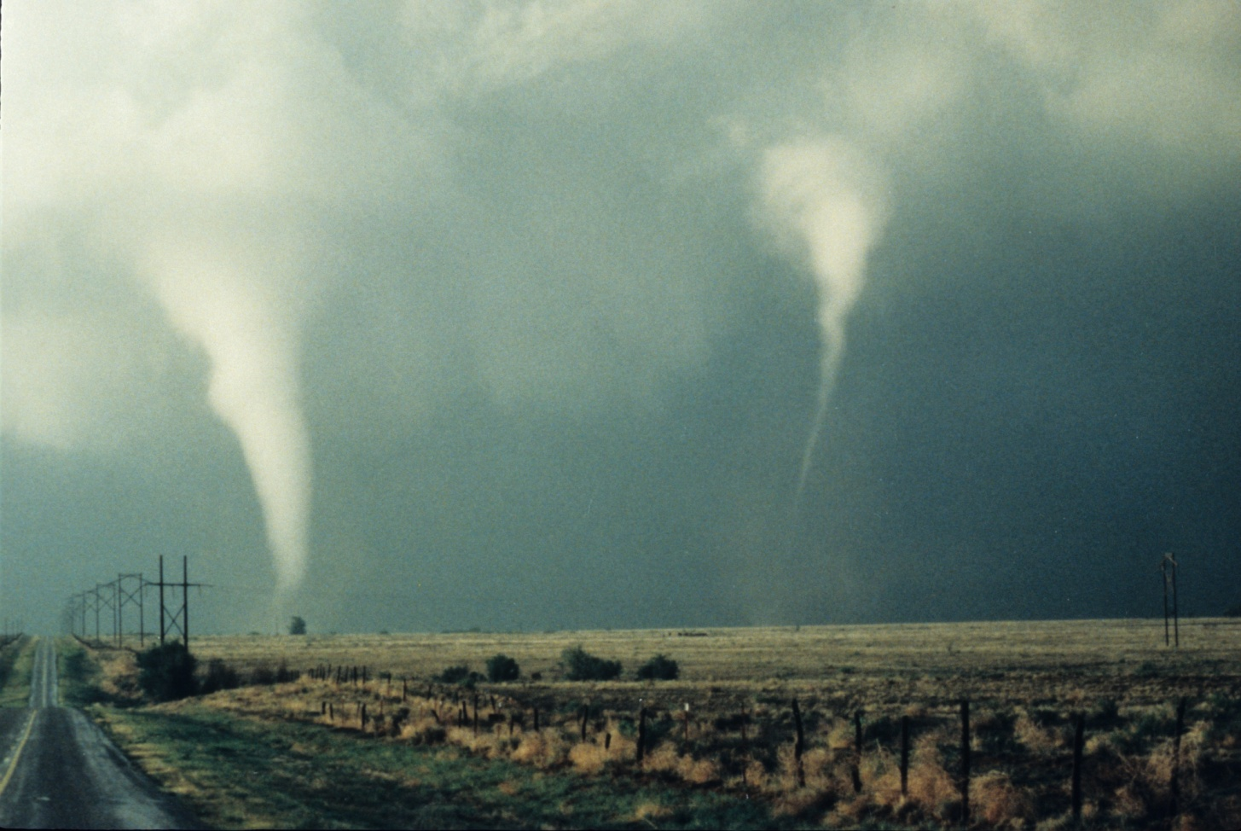
Module 1 – May 5 The Tornado Strikes

Slide 17
Module 1 – May 5, 1500 hrs
Low-hanging clouds and scattered bursts of rain move into the area and the wind picks up, alternating between warm and cool gusts − in the distance the skies have an ominous muddy green color
The rain and wind abruptly stop but then hail, ranging from the size of peas up to golf balls, begins to pound the area
Suddenly the hail stops and is followed by a torrent of rain and a wall cloud that forms to the south of the area − sirens sound an alert
Notes:
17

Slide 18
Key Issues – Module 1
The average time between the siren’s alert and the tornado is 10 minutes
Three out of every four tornado sirens are false alarms, so employees react promptly but without too much concern
Weather reports indicate the highest wind speeds are in the northeastern part of the city, where the source water and drinking water facilities are located
Power and landline phone services are out or limited in some areas of the city
Notes:
Based on the information provided, encourage players to participate in a discussion concerning the issues raised in Module 1. Identify any critical issues, decisions, requirements or questions that should be addressed at this time.
The following questions are provided as suggested subjects that you may wish to address as the discussion progresses. These questions are not meant to constitute a definitive list of concerns to be addressed, nor is there a requirement to address every question.
[What existing tornado preparedness measures does your utility have in place? For example, what plans do you have for safeguarding supplies and equipment, or obtaining them from outside of the impacted area?]
[What further tornado proofing measures could be implemented?]
[How would you receive notification of a tornado that directly impacts your facility? Elsewhere in your service area?]
[What protective employee actions and operational actions would occur immediately after a tornado warning siren sounds?]
[How will communications be handled to internal staff, to the public and to officials? How will these procedures be carried out in the event of electricity or phone service interruptions?]

Slide 19
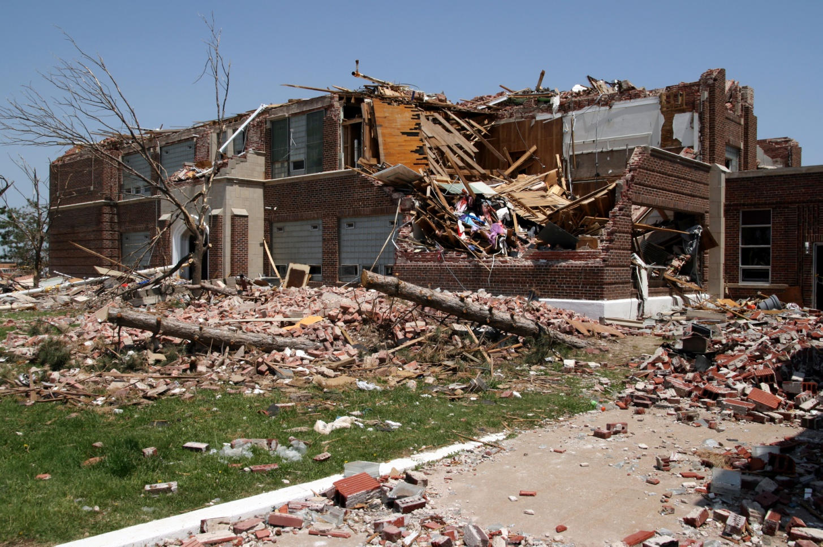
Module 2 – May 5 Aftermath of the Tornado

Slide 20
Module 2 – May 5, 1615 hrs
The tornado destroyed homes and businesses and left debris in the roadways
In some parts of the city, buildings, structures, above-ground utilities and shallow buried natural gas lines were damaged
Flash flooding created wash-outs of water and sewer pipes, and cutoff roads in low-lying areas
Officials are calling for assistance in the form of heavy equipment and operators
Vehicles are disabled due to tire punctures from sharp debris on the roadways

Slide 21
Key Issues – Module 2
No one is injured, but some drinking water utility structures are badly damaged
The roof has blown off the main building where engineering, laboratory, customer services and payments departments are housed
Damage to the control equipment and computers inside the buildings is unknown, electrical service is out and the structure is too dangerous to enter

Slide 22
Key Issues – Module 2 (cont.)
Vehicles in the parking lot have been thrown on top of each other and drums of what may be sodium hypochlorite from the chemical delivery truck have been scattered − some canisters are damaged and leaking
A 250,000-gallon elevated water storage tank has collapsed
Across the service area, debris damage and washouts have severed drinking water lines and adjacent sewer lines, potentially causing cross-contamination

Slide 23
Key Issues – Module 2 (cont.)
The drinking water utility has indicated a drop in water pressure in several neighborhoods that are hardest hit by the tornado −a preliminary damage assessment indicates that the collapsed elevated water tank served these neighborhoods
The drinking water utility does not have the manpower or equipment to maintain 24/7 emergency response for the several weeks required to make repairs and resume most normal operations

Slide 24
Key issues module 2
Key Issues – Module 2 (cont.)
Emergency officials want all heavy equipment to be utilized for immediate emergency debris removal, which will further delay water response and recovery operations
The wastewater utility has also suffered severe structural damage to the plant facilities, but no employees are injured
A damage assessment indicates the administrative building is damaged, a workshop is completely destroyed, electrical power to the main raw sewage pumps is disrupted and several aeration basins have suffered structural damage − operators speculate that this will affect both collection and treatment processes

Slide 25
Key issues module 2
Key Issues – Module 2 (cont.)
One key lift station is without power and is difficult to access due to piles of debris
The entire area is covered in debris, including cars, trees and unknown gas or chemical cylinders that the tornado scattered − one of the cylinders has valve damage and is leaking an orange-colored gas while another one is leaking white vapor that floats along the ground
Utility management is concerned for the safety of personnel and the public

Slide 26
Key issues – module 2
Key Issues – Module 2 (cont.)
Some of the crews that were out on call have not answered their radios or cell phones
The utility has backup generators and mobile pumps, but officials want to use the pumps for other response efforts
Notes:
Based on the information provided, encourage players to participate in a discussion concerning the issues raised in Module 2. Identify any critical issues, decisions, requirements or questions that should be addressed at this time.
The following questions are provided as suggested subjects that you may wish to address as the discussion progresses. These questions are not meant to constitute a definitive list of concerns to be addressed, nor is there a requirement to address every question.
[What procedures have been developed to assess this kind of incident and to take initial actions to support the response?]
[What options are available to get outside help? Would your immediate neighbors be similarly affected?]
[How will communications be handled, both to utility staff and externally to the public, the business community and elected and other government officials?]
[How do you determine if an advisory or public notification (such as boil water or do not use) needs to be issued for this incident? What alternative resources could be available to issue an advisory if normal communication media such as TV and radio outlets are unavailable?]
[If alternate drinking water or wastewater services need to be provided, what are those and who provides them?]
[What is your process for prioritizing repairs?]
[What additional resources (e.g., staff, heavy equipment and generators) would your utility need to repair damage and restore service? Where will they come from?]

Slide 27
Action planning session post exercise
Action Planning Session
Post-Exercise “Hot Wash”

Slide 28
Review of exercise objectives
Review of Exercise Objectives
Explore and address cybersecurity challenges
Define or refine participants’ roles and responsibilities for managing the consequences of a cybersecurity incident, which should be reflected in their plans, policies and procedures and other preparedness elements currently in place or under development
Build relationships between utilities and stakeholders
Increase awareness of the damage that can be caused by a cybersecurity incident on a business or control system
Identify other needed enhancements related to training and exercises and other preparedness elements currently in place or under development
Notes:
Discuss each objective and corresponding outcome.

Slide 29
conclusion
Conclusion
Please turn in your notes from the Action Planning Session, your participant evaluation form and any additional comments you wish to share
This information will be used to develop an After Action Report and Improvement Plan

Slide 30
Closing remarks thank you for participating
Closing Remarks
Thank you for participating

