Slide 1
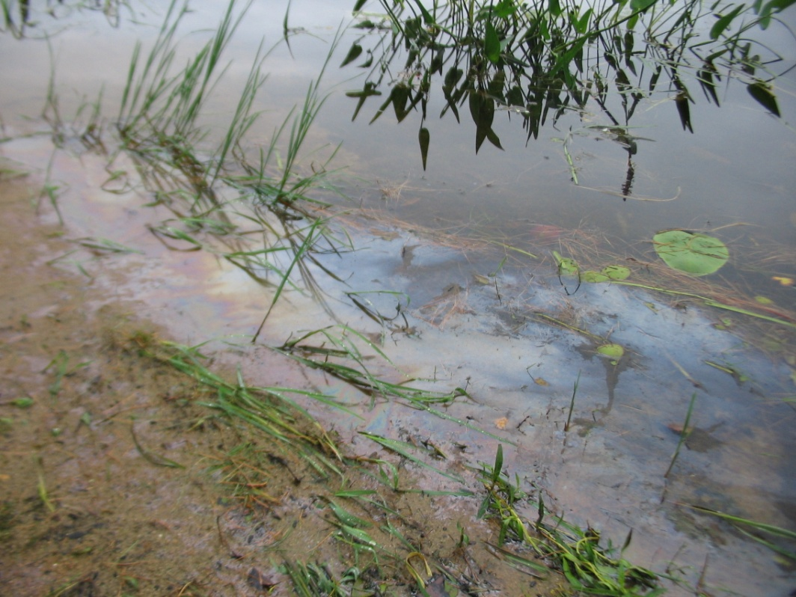
Source water contamination scenario
Source Water Contamination Scenario
Tabletop Exercise
Notes:
The Scenario Presentation is a multimedia presentation used by the facilitator during the tabletop exercise to present the material in the Situation Manual (SitMan). The Scenario Presentation is put together from and follows the same order as the SitMan. Most users will find it easier to develop the Scenario Presentation after they have finalized the SitMan.
All of the slides presented here may be modified as needed. For example, an Exercise Development Team (EDT) may decide not to include all or part of the slides presented here since the same information is already available to participants through their SitMan.
Facilitators are encouraged to use this “notes” section on each slide to incorporate additional material, such as follow-up questions or comments.

Slide 2
Tabletop Exercise
Welcome and introductions
Discuss agenda for the day
Review administrative details
Start the exercise

Slide 3
Welcome and Introductions
Name
Organization
Emergency response experience

Slide 4
Agenda
Review exercise materials and rules
Review scenario(s)
Break
Facilitated discussion period
Action planning session (“hot wash”)
Review and conclusion
Closing comments

Slide 5
Administrative Details
Location of emergency exits
Location of restrooms
Cell phone and pager management
Logging your time to fulfill training requirements
Sign-in sheet and participant evaluation form

Slide 6
Exercise Benefits:
Increase readiness in the event of an actual emergency
Provide a means to assess effectiveness of response plans and response capabilities
Serve as a training tool for response personnel and their involvement with other response agencies
Provide an opportunity to practice skills and improve individual performance in a non-threatening environment

Slide 7
Exercise Benefits: (cont.)
Require participants to network with each other and pre-plan decisions on resources
Identify planning conflicts or gaps
Identify resource needs and opportunities for sharing of resources
Clarify internal and external roles and responsibilities

Slide 8
Exercise Objectives:
At the conclusion of this exercise, participants should be able to do the following:
Define or refine participants’ roles and responsibilities for managing the consequences of a source water contamination incident, which should be reflected in their plans, policies, procedures and other preparedness elements currently in place or under development
Build relationships between utilities and stakeholders
Notes:
8

Slide 9
Exercise Objectives: (cont.)
Determine neighboring utility water infrastructure capabilities and needs
Identify other needed enhancements related to training and exercises and other preparedness elements currently in place or under development
This session will not be a success unless you as a participant go back to your office and follow through
Notes:
9

Slide 10
Roles and Responsibilities:
Players respond to the situation presented based on expert knowledge of response procedures, current plans and procedures and insights derived from training and experience
Observers observe the exercise but do not participate in the facilitated discussion period
Facilitators lead the exercise by presenting the scenario narrative and facilitating the discussion period and “hot wash” (Action planning session or review session)
Evaluators monitor the exercise, track accomplishments according to objectives and may ask questions

Slide 11
Exercise Rules:
This exercise will be held in an open, low-stress no-fault environment − varying viewpoints, even disagreements, are expected
Respond to the scenario using your knowledge of current plans and capabilities (i.e., you may use only existing assets) and insights derived from your training
Decisions are not precedent setting and may not reflect your organization’s final position on a given issue − this exercise is an opportunity to discuss and present multiple options and possible solutions

Slide 12
Exercise Rules: (cont.)
Issue identification is not as valuable as suggestions and recommended actions that could improve [prevention, protection, mitigation, response or recovery] efforts − problem-solving efforts should be the focus
Assume there will be cooperation and support from other responders and agencies
The basis for discussion consists of the scenario narrative and modules, your experience, your understanding of your Emergency Response Plan (ERP), your intuition and other utility resources included as part of this material or that you brought with you
Treat the scenario as if it will affect your area

Slide 13
Action planning session
Action Planning Session:
Following the facilitated discussion period, the facilitator will lead an Action Planning Session, also known as a “hot wash”
Participants are encouraged to identify, discuss and prioritize next steps, actions, tasks and other follow-up activities
Identify additional collaborators if needed
Schedule a follow-up meeting

Slide 14
Cybersecurity scenario
Source Water Contamination Scenario

Slide 15
Background
It is late summer, and the region is experiencing moderate drought conditions
The drinking water utility relies on the local river as its source water − there is a small back up reservoir, but its levels are lower than usual due to drought
The river is bordered on one side by conservation land and on the other side by a large highway
The highway serves as a major thoroughfare for transportation of oil and other materials

Slide 16
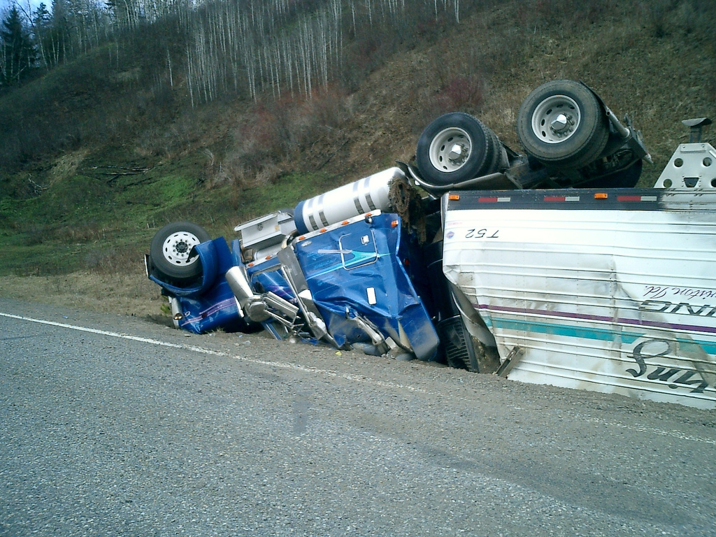
Module 1 – August 24 Upstream Contamination Occurs

Slide 17
Module 1 – August 24, 0300 hrs
A tank truck driver falls asleep and crashes his truck, rolling from the road into a ditch
The truck’s tanker continues to roll, and comes to a stop near the river’s shoreline
The driver survives the impact but remains unconscious
There are no witnesses
Forty-five minutes later, a police officer notices the truck cab in the ditch − she calls for emergency medical services, but remains with the driver rather than investigating the surroundings
Notes:
17

Slide 18
Module 1 – August 24, 0300 hrs (cont.)
Medical staff attend to the driver while police and fire personnel assess the scene of the accident − the tanker seems to be spilling its contents into the river
Operators for the city’s drinking water plant are waking up and heading to work
The lead operator hears news of the crash and spill on the local AM radio station as he drives to work
When he arrives at the plant, the night shift operator tells him that the state environmental agency called about a spill of an unknown substance upstream of the plant’s intake
Notes:
18

Slide 19
Key Issues – Module 1
The drinking water utility has one intake
Water treatment consists of coagulation, flocculation, sedimentation, filtration and disinfection − in addition, softening, pH adjustment and fluoridation are also performed
A sample of the leaking substance is collected, but it will take some time before decisive analytical results are reported
Notes:
19

Slide 20
Key Issues – Module 1 (cont.)
The truck’s manifest has not been located
First responders noted that the spilled liquid smelled like gasoline or another petroleum product, and initial screening testing performed by fire hazmat personnel indicate petroleum as well
Notes:
20

Slide 21
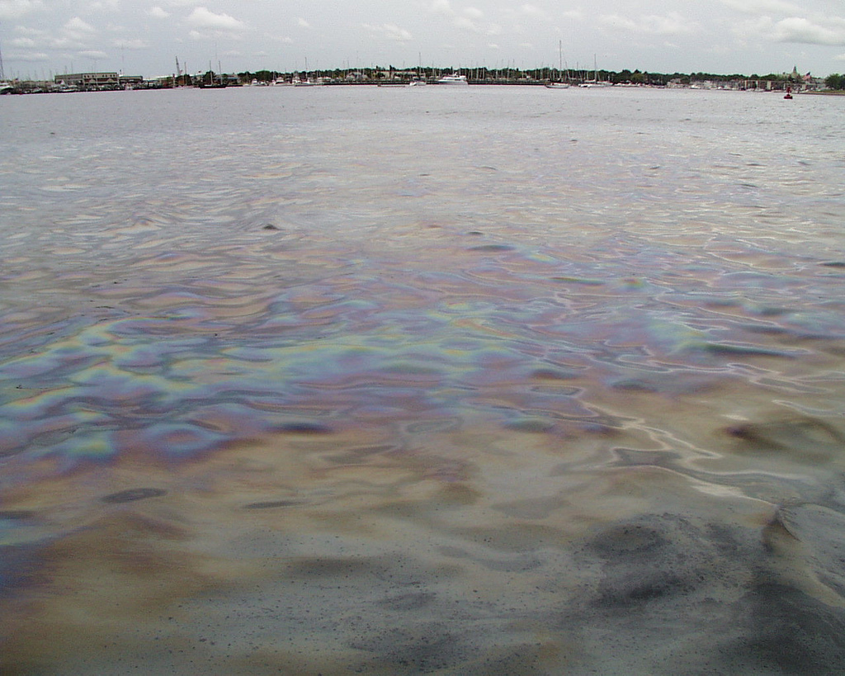
Module 2 – August 24 Contamination Nears Drinking Water Intake

Slide 22
Module 2 – August 24, 0900 hrs
A visible, expanding sheen now coats the width of the river directly downstream of the crash site − EPA and the state environmental agency are assessing the situation
The leak is composed of an unknown quantity of number 2 fuel oil (a distillate home heating oil)
The U.S. Army Corps of Engineers (USACE) conducts surveillance by helicopter to assess the full extent of the sheen and the speed at which it is moving down the river

Slide 23
Module 2 – August 24, 0900 hrs (cont.)
Based on their observations and knowledge of oil spill management, the USACE calculates the sheen will arrive at the city’s intake in approximately 8 hours
The utility decides that protective actions should be taken, but due to low reservoir levels and high summer demands, they will wait to shut the city’s intake until the sheen gets closer

Slide 24
Key Issues – Module 2
The utility owns several inflatable booms that can protect intake pipes from contaminants that are less dense than water
Based on a river time of travel model maintained by local emergency management, the contaminant is expected to arrive at the city’s intake at 1700 hours
Predictions of contaminant arrival time are inexact and may change depending on weather conditions
Notes:
Based on the information provided, encourage players to participate in a discussion concerning the issues raised in Module 2. Identify any critical issues, decisions, requirements or questions that should be addressed at this time.
The following questions are provided as suggested subjects that you may wish to address as the discussion progresses. These questions are not meant to constitute a definitive list of concerns to be addressed, nor is there a requirement to address every question.
[How and from whom will your utility continue to receive updated information as the situation evolves?]
[What protective actions can be implemented at your utility to prevent contamination, especially since the intake is still active?]
[What response partner agencies will be involved in these protective actions? How will communication between response partners be carried out and coordinated?]
[What sampling and analysis procedures does your utility have in place to address the incident? What laboratory capabilities will be required in response to this incident? How will the laboratories you work with be impacted by the increased demand for testing resulting from this incident?]
[What would your water quality message be to the public, as some may be concerned that the river (and therefore their drinking water) has been polluted? What strategies do you employ for encouraging short term water conservation?]
[What communication mechanisms are available to utilities to disseminate information to the public?]
[Who at your utility would keep any upstream and downstream utilities informed of the evolving situation?]

Slide 25
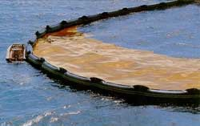
Module 3 – August 24 Contamination Reaches Drinking Water Intake

Slide 26
Module 3 – August 24, 1400 hrs
The wind’s direction shifts and its strength increases
The higher wind speed causes the sheen to move more quickly toward the intake
The sheen is now predicted to arrive within the hour, not 1700
Utility and local emergency management agency staff race to boom off the intake
Utility employees rush to turn off the intake’s pump, but communication issues cause a delay in shutdown

Slide 27
Key Issues – Module 3
Utility staff estimates that in the time before pump shut down, about 10,000 gallons of contaminated water entered the intake
The capacity of the existing treatment system to treat petroleum contamination is unknown
The city may now have to rely solely on water in storage until it can be determined how treatable the contaminated water is
Decontamination of parts of the water treatment plant may be necessary
Notes:
Based on the information provided, encourage players to participate in a discussion concerning the issues raised in Module 3. Identify any critical issues, decisions, requirements or questions that should be addressed at this time.
The following questions are provided as suggested subjects that you may wish to address as the discussion progresses. These questions are not meant to constitute a definitive list of concerns to be addressed, nor is there a requirement to address every question.
[How would your utility be represented in the Emergency Operations Center for this incident?]
[What precautions would your utility take so that contaminated water does not enter the distribution system? Does your utility have plans in place in the event that contaminated water does enter the distribution system?]
[How long could your utility maintain adequate pressure in the system using only water in the pipes and storage facilities? What water conservation procedures can your utility implement with customers to help ensure that storage is maximized for emergencies such as fires?]
[Does your utility have an alternate drinking water supply plan? If not, who in the jurisdiction is planning on providing and distributing alternate drinking water?]
[Does your utility have remediation and recovery plans in place? What decontamination resources are available for the intake and the water treatment plant? If your utility has no plans, where would the technical expertise come from to develop a remediation and recovery plan?]

Slide 28
Action planning session post exercise
Action Planning Session
Post-Exercise “Hot Wash”

Slide 29
Review of exercise objectives
Review of Exercise Objectives
Explore and address cybersecurity challenges
Define or refine participants’ roles and responsibilities for managing the consequences of a cybersecurity incident, which should be reflected in their plans, policies and procedures and other preparedness elements currently in place or under development
Build relationships between utilities and stakeholders
Increase awareness of the damage that can be caused by a cybersecurity incident on a business or control system
Identify other needed enhancements related to training and exercises and other preparedness elements currently in place or under development
Notes:
Discuss each objective and corresponding outcome.

Slide 30
conclusion
Conclusion
Please turn in your notes from the Action Planning Session, your participant evaluation form and any additional comments you wish to share
This information will be used to develop an After Action Report and Improvement Plan

Slide 31
Closing remarks thank you for participating
Closing Remarks
Thank you for participating

