Slide 1
Radiological dispersion device
Radiological Dispersion Device Scenario
Tabletop Exercise
Notes:
The Scenario Presentation is a multimedia presentation used by the facilitator during the tabletop exercise to present the material in the Situation Manual (SitMan). The Scenario Presentation is put together from and follows the same order as the SitMan. Most users will find it easier to develop the Scenario Presentation after they have finalized the SitMan.
All of the slides presented here may be modified as needed. For example, an Exercise Development Team (EDT) may decide not to include all or part of the slides presented here since the same information is already available to participants through their SitMan.
Facilitators are encouraged to use this “notes” section on each slide to incorporate additional material, such as follow-up questions or comments.

Slide 2
Tabletop Exercise
Welcome and introductions
Discuss agenda for the day
Review administrative details
Start the exercise

Slide 3
Welcome and Introductions
Name
Organization
Emergency response experience

Slide 4
Agenda
Review exercise materials and rules
Review scenario(s)
Break
Facilitated discussion period
Action planning session (“hot wash”)
Review and conclusion
Closing comments

Slide 5
Administrative Details
Location of emergency exits
Location of restrooms
Cell phone and pager management
Logging your time to fulfill training requirements
Sign-in sheet and participant evaluation form

Slide 6
Exercise Benefits:
Increase readiness in the event of an actual emergency
Provide a means to assess effectiveness of response plans and response capabilities
Serve as a training tool for response personnel and their involvement with other response agencies
Provide an opportunity to practice skills and improve individual performance in a non-threatening environment

Slide 7
Exercise Benefits: (cont.)
Require participants to network with each other and pre-plan decisions on resources
Identify planning conflicts or gaps
Identify resource needs and opportunities for sharing of resources
Clarify internal and external roles and responsibilities

Slide 8
Exercise Objectives:
At the conclusion of this exercise, participants should be able to do the following:
Define or refine participants’ roles and responsibilities for managing the consequences of a radiological dispersion device incident, which should be reflected in their plans, policies and procedures and other preparedness elements currently in place or under development
Build relationships between utilities and stakeholders
Notes:
8

Slide 9
Exercise Objectives: (cont.)
Determine neighboring utility water infrastructure capabilities and needs
Identify other needed enhancements related to training and exercises and other preparedness elements currently in place or under development
This session will not be a success unless you as a participant go back to your office and follow through
Notes:
9

Slide 10
Roles and Responsibilities:
Players respond to the situation presented based on expert knowledge of response procedures, current plans and procedures and insights derived from training and experience
Observers observe the exercise but do not participate in the facilitated discussion period
Facilitators lead the exercise by presenting the scenario narrative and facilitating the discussion period and “hot wash” (Action planning session or review session)
Evaluators monitor the exercise, track accomplishments according to objectives and may ask questions

Slide 11
Exercise Rules:
This exercise will be held in an open, low-stress no-fault environment − varying viewpoints, even disagreements, are expected
Respond to the scenario using your knowledge of current plans and capabilities (i.e., you may use only existing assets) and insights derived from your training
Decisions are not precedent setting and may not reflect your organization’s final position on a given issue − this exercise is an opportunity to discuss and present multiple options and possible solutions

Slide 12
Exercise Rules: (cont.)
Issue identification is not as valuable as suggestions and recommended actions that could improve [prevention, protection, mitigation, response or recovery] efforts − problem-solving efforts should be the focus
Assume there will be cooperation and support from other responders and agencies
The basis for discussion consists of the scenario narrative and modules, your experience, your understanding of your Emergency Response Plan (ERP), your intuition and other utility resources included as part of this material or that you brought with you
Treat the scenario as if it will affect your area

Slide 13
Action planning session
Action Planning Session:
Following the facilitated discussion period, the facilitator will lead an Action Planning Session, also known as a “hot wash”
Participants are encouraged to identify, discuss and prioritize next steps, actions, tasks and other follow-up activities
Identify additional collaborators if needed
Schedule a follow-up meeting

Slide 14
Cybersecurity scenario
Radiological Dispersion Device Scenario

Slide 15
Module 1 – April 24 The Threat

Slide 16
Module 1 – April 24, 2000 hrs
Tuesday evening’s news reports that regional counterterrorism teams are active in the state
A request is made for the public to be aware and notify authorities of persons exhibiting unusual behavior
Late in the evening, the utility receives a call from the police department that a resident reported seeing an unusual vehicle parked near the utility fence line
Police investigated, but no one was there
Notes:
16

Slide 17
Key Issues – Module 1
The drinking water facility is located near several other government buildings
The sighting of suspicious persons or vehicles on utility property is uncommon
Notes:
Based on the information provided, encourage players to participate in a discussion concerning the issues raised in Module 1. Identify any critical issues, decisions, requirements or questions that should be addressed at this time.
The following questions are provided as suggested subjects that you may wish to address as the discussion progresses. These questions are not meant to constitute a definitive list of concerns to be addressed, nor is there a requirement to address every question.
[What procedures does your utility have in place to monitor security threats and maintain situational awareness?]
[Would you take any preventive action after the suspicious vehicle is sighted near your facility?]
[What is your message for your utility’s employees?]

Slide 18
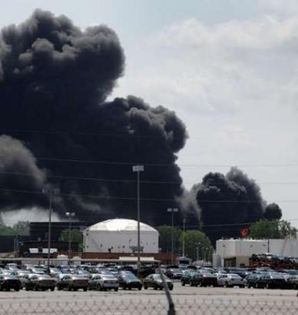
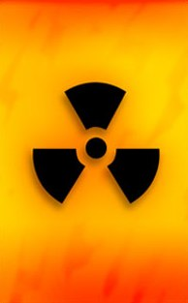
Module 2 – April 25 The Radiological Dispersion Device Is Detonated

Slide 19
Module 2 – April 25, 1200 hrs
A loud, muffled explosion is heard that shakes the walls of the drinking water utility and other buildings in the area
Sirens are heard coming from the same direction that the utility’s storage tanks and reservoirs are located
Soon after, both the drinking water and wastewater utilities are notified to attend an emergency meeting at the county’s Emergency Operations Center (EOC)

Slide 20
Key Issues – Module 2
No unusual smells or debris were noted near the drinking water facilities in the minutes following the explosion
Utility workers observe traffic beginning to back up in the direction of the storage tanks and reservoirs
Notes:
Based on the information provided, encourage players to participate in a discussion concerning the issues raised in Module 2. Identify any critical issues, decisions, requirements or questions that should be addressed at this time.
The following questions are provided as suggested subjects that you may wish to address as the discussion progresses. These questions are not meant to constitute a definitive list of concerns to be addressed, nor is there a requirement to address every question.
[What initial actions would you take?]
[What procedures have been developed to assess the incident and take initial action to support the response?]
[Whom would you contact (e.g., local, state agencies) as a result of what you heard, felt and observed?]
[What procedures have been developed to ensure employee safety during potentially violent incidents?]

Slide 21
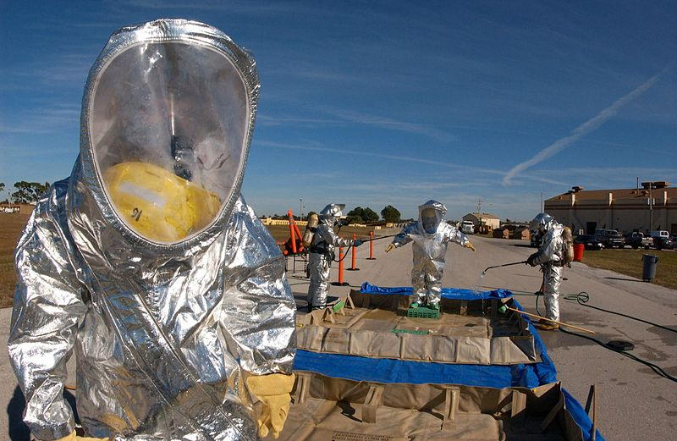
Module 3 – April 25 Response Begins

Slide 22
Module 3 – April 25, 1300 hrs
At the EOC it is announced that terrorists detonated an improvised radiological dispersion device in the area of the drinking water reservoirs
There is significant damage to other government buildings in that area, with two deaths reported
Reports indicate that the explosion contained cesium 137, cobalt-60, cesium chloride and/or uranium dust
State and federal response teams will be arriving, an evacuation is in process, the local EOC is fully activated and an Incident Command System (ICS) organization has been implemented

Slide 23
Module 3 – April 25, 1300 hrs (cont.)
Response team officials present a map of an air plume analysis and estimates of where wind will carry and deposit the radiological particulates and by what time
The response team subject matter experts clarify that the air models can change, and field surveys have yet to confirm actual particulate amounts
Some of the drinking water reservoirs are in the plume’s path − utility personnel begin reviewing the Water Contaminant Information Tool (WCIT)

Slide 24
Key Issues – Module 3
The water utility representatives realize that two of the three main water reservoirs are covered tanks with open vents located within the area that will likely be affected by higher concentrations of radioactive particulates − it is estimated that the water distribution system that draws from these tanks serves 10 percent of the customer population
The water utility representatives also realize that the estimate indicates that three hours later, a less dangerous level of radioactive particulates might reach the water pump station that controls the intake from the raw water reservoirs − utility personnel in the area may also become contaminated

Slide 25
Key Issues – Module 3 (cont.)
News media has made several uncorroborated broadcasts about the safety of the drinking water and the utility’s call center is overwhelmed with calls from concerned customers
The water utility representatives are unsure how long radiochemical water sample analyses will take and request HazMat and laboratory assistance
The air plume analysis indicates that the wastewater plant is located outside the path of contaminants carried by wind − however, wastewater utility representatives are concerned about receiving contaminated drinking water from potentially affected neighborhoods

Slide 26
Key Issues – Module 3 (cont.)
The state wastewater permitting authorities and hazardous material response team work together to calculate that if it rains as predicted, storm water runoff and drainage from the impacted areas served by a combined wastewater and storm water collection system may become highly contaminated and reach the wastewater plant within two days

Slide 27
Key issues – module 3
Key Issues – Module 3 (cont.)
The level of radiation that might arrive at the wastewater plant via storm water is unknown, but is projected to contaminate the wastewater treatment plant systems as well as the activated sludge, water, biosolids and ambient air in and around the plant − utility personnel may also be at risk to contamination and the entire facility may become uninhabitable
The wastewater utility representatives are unsure how to arrange for continual radiological analyses of plant influent and effluent

Slide 28
Key Issues – Module 3 (cont.)
Drinking water utilities downstream from the wastewater utility are concerned and want to know what is being done to protect the river and their other water sources from contamination
Additionally, water and wastewater utilities report that some personnel are requesting time off to evacuate their families and are concerned about the health risks of reporting for work
Notes:
Based on the information provided, encourage players to participate in a discussion concerning the issues raised in Module 3. Identify any critical issues, decisions, requirements or questions that should be addressed at this time.
The following questions are provided as suggested subjects that you may wish to address as the discussion progresses. These questions are not meant to constitute a definitive list of concerns to be addressed, nor is there a requirement to address every question.
[With whom do you coordinate your response and remediation actions? How are response plans altered by incoming state, and potentially federal, responders?]
[Who is responsible for internal and external (i.e., public) communication activities during this incident?]
[Would you and your employees shelter in place or evacuate?]
[What procedures have been developed for conducting sampling and analysis to confirm contamination?]
[What resources are available to perform the field sampling, laboratory testing and system analysis? How would employees be protected from potential exposure to radiation?]
[What laboratory capabilities will be required in response to this incident? How will the laboratories you work with be impacted by the increased demand for testing resulting from this incident?]

Slide 29
Action planning session post exercise
Action Planning Session
Post-Exercise “Hot Wash”

Slide 30
Review of exercise objectives
Review of Exercise Objectives
Explore and address cybersecurity challenges
Define or refine participants’ roles and responsibilities for managing the consequences of a cybersecurity incident, which should be reflected in their plans, policies and procedures and other preparedness elements currently in place or under development
Build relationships between utilities and stakeholders
Increase awareness of the damage that can be caused by a cybersecurity incident on a business or control system
Identify other needed enhancements related to training and exercises and other preparedness elements currently in place or under development
Notes:
Discuss each objective and corresponding outcome.

Slide 31
conclusion
Conclusion
Please turn in your notes from the Action Planning Session, your participant evaluation form and any additional comments you wish to share
This information will be used to develop an After Action Report and Improvement Plan

Slide 32
Closing remarks thank you for participating
Closing Remarks
Thank you for participating

