Slide 1
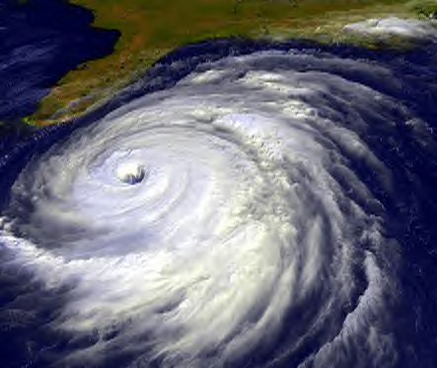
Hurrican scenario
Hurricane Scenario
Tabletop Exercise
Notes:
The Scenario Presentation is a multimedia presentation used by the facilitator during the tabletop exercise to present the material in the Situation Manual (SitMan). The Scenario Presentation is put together from and follows the same order as the SitMan. Most users will find it easier to develop the Scenario Presentation after they have finalized the SitMan.
All of the slides presented here may be modified as needed. For example, an Exercise Development Team (EDT) may decide not to include all or part of the slides presented here since the same information is already available to participants through their SitMan.
Facilitators are encouraged to use this “notes” section on each slide to incorporate additional material, such as follow-up questions or comments.

Slide 2
Tabletop Exercise
Welcome and introductions
Discuss agenda for the day
Review administrative details
Start the exercise

Slide 3
Welcome and Introductions
Name
Organization
Emergency response experience

Slide 4
Agenda
Review exercise materials and rules
Review scenario(s)
Break
Facilitated discussion period
Action planning session (“hot wash”)
Review and conclusion
Closing comments

Slide 5
Administrative Details
Location of emergency exits
Location of restrooms
Cell phone/pager management
Logging your time to fulfill training requirements
Sign-in sheet and participant evaluation form

Slide 6
Exercise Benefits:
Increase readiness in the event of an actual emergency
Provide a means to assess effectiveness of response plans and response capabilities
Serve as a training tool for response personnel and their involvement with other response agencies
Provide an opportunity to practice skills and improve individual performance in a non-threatening environment

Slide 7
Exercise Benefits: (cont.)
Require participants to network with each other and pre-plan decisions on resources
Identify planning conflicts or gaps
Identify resource needs and opportunities for sharing of resources
Clarify internal and external roles and responsibilities

Slide 8
Exercise Objectives:
At the conclusion of this exercise, participants should be able to do the following:
Define or refine participants’ roles and responsibilities for managing the consequences of a hurricane incident, which should be reflected in their plans, policies and procedures and other preparedness elements currently in place or under development
Build relationships between utilities and stakeholders
Notes:
8

Slide 9
Exercise Objectives: (cont.)
Determine neighboring utility water infrastructure capabilities and needs
Identify other needed enhancements related to training and exercises and other preparedness elements currently in place or under development
This session will not be a success unless you as a participant go back to your office and follow through
Notes:
9

Slide 10
Roles and Responsibilities:
Players respond to the situation presented based on expert knowledge of response procedures, current plans and procedures and insights derived from training and experience
Observers observe the exercise but do not participate in the facilitated discussion period
Facilitators lead the exercise by presenting the scenario narrative and facilitating the discussion period and “hot wash” (Action planning session or review session)
Evaluators monitor the exercise, track accomplishments according to objectives and may ask questions

Slide 11
Exercise Rules:
This exercise will be held in an open, low-stress, no-fault environment − varying viewpoints, even disagreements, are expected
Respond to the scenario using your knowledge of current plans and capabilities (i.e., you may use only existing assets) and insights derived from your training
Decisions are not precedent setting and may not reflect your organization’s final position on a given issue − this exercise is an opportunity to discuss and present multiple options and possible solutions

Slide 12
Exercise Rules: (cont.)
Issue identification is not as valuable as suggestions and recommended actions that could improve [prevention, protection, mitigation, response or recovery] efforts − problem-solving efforts should be the focus
Assume there will be cooperation and support from other responders and agencies
The basis for discussion consists of the scenario narrative and modules, your experience, your understanding of your Emergency Response Plan (ERP), your intuition and other utility resources included as part of this material or that you brought with you
Treat the scenario as if it will affect your area

Slide 13
Action planning session
Action Planning Session:
Following the facilitated discussion period, the facilitator will lead an Action Planning Session, also known as a “hot wash”
Participants are encouraged to identify, discuss and prioritize next steps, actions, tasks and other follow-up activities
Identify additional collaborators if needed
Schedule a follow-up meeting

Slide 14
Cybersecurity scenario
Hurricane Scenario

Slide 15
Background
Hurricane Mariana, a Category 3 storm with sustained winds of 115 mph, is intensifying and rapidly approaching the coast on Labor Day weekend
The National Hurricane Center is predicting that the storm will make landfall in three days
However, damaging high surf combined with a lunar high tide and heavy rainfall is expected in two days, which will result in flooding and significant shoreline erosion

Slide 16
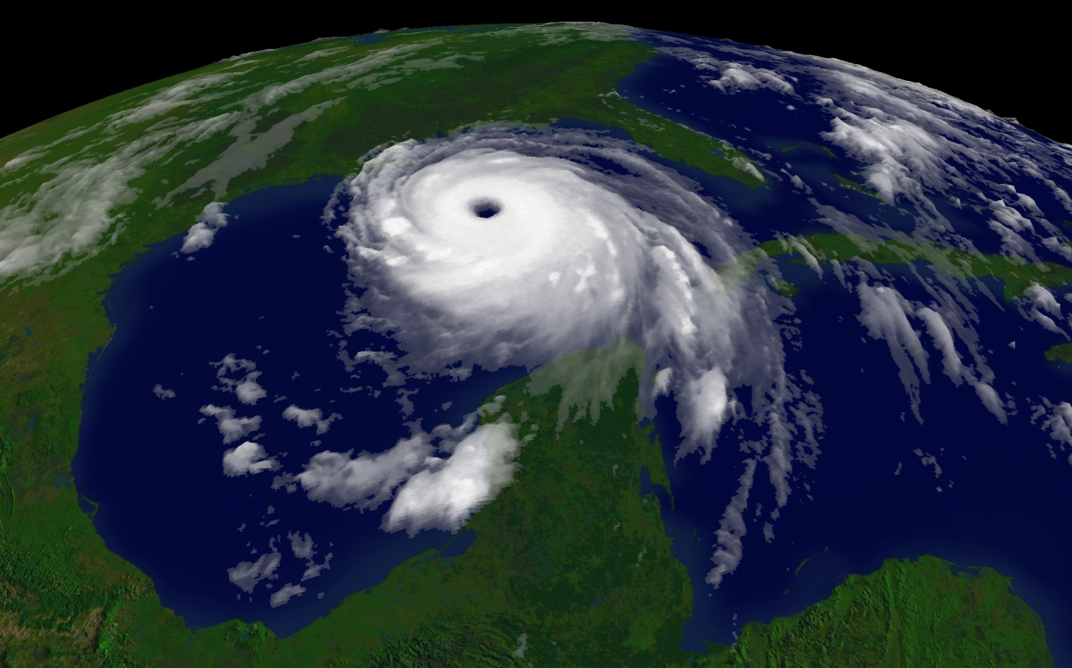
Module 1 – September 2 Before Landfall

Slide 17
Module 1 – September 2, 1300 hrs
The county and state Emergency Operations Centers have been activated
Residents and visitors are being evacuated from low-lying coastal areas
Notes:
17

Slide 18
Key Issues – Module 1
Many utility staff members ask to leave work and assist their families to evacuate − others are out on vacation
The water utility has at least one generator that is inoperable, and the wastewater utility is down one diesel fuel storage tank as it is being cleaned and refurbished by an outside contractor
Notes:
Based on the information provided, encourage players to participate in a discussion concerning the issues raised in Module 1. Identify any critical issues, decisions, requirements or questions that should be addressed at this time.
The following questions are provided as suggested subjects that you may wish to address as the discussion progresses. These questions are not meant to constitute a definitive list of concerns to be addressed, nor is there a requirement to address every question.
[What pre-incident planning could have been completed prior to this emergency to minimize impacts to utility operation?]
[How will you and your staff gather information about the approaching hurricane?]
[How will you activate your emergency procedures and protocols?]
[Should the Incident Command System (ICS) be established at your utility? When should it be established? How does your ICS structure fit into the larger response structure established to manage the storm across the affected region?]
[What are your backup power requirements for essential facilities and equipment? What are your fueling needs for on-site backup generators?]

Slide 19
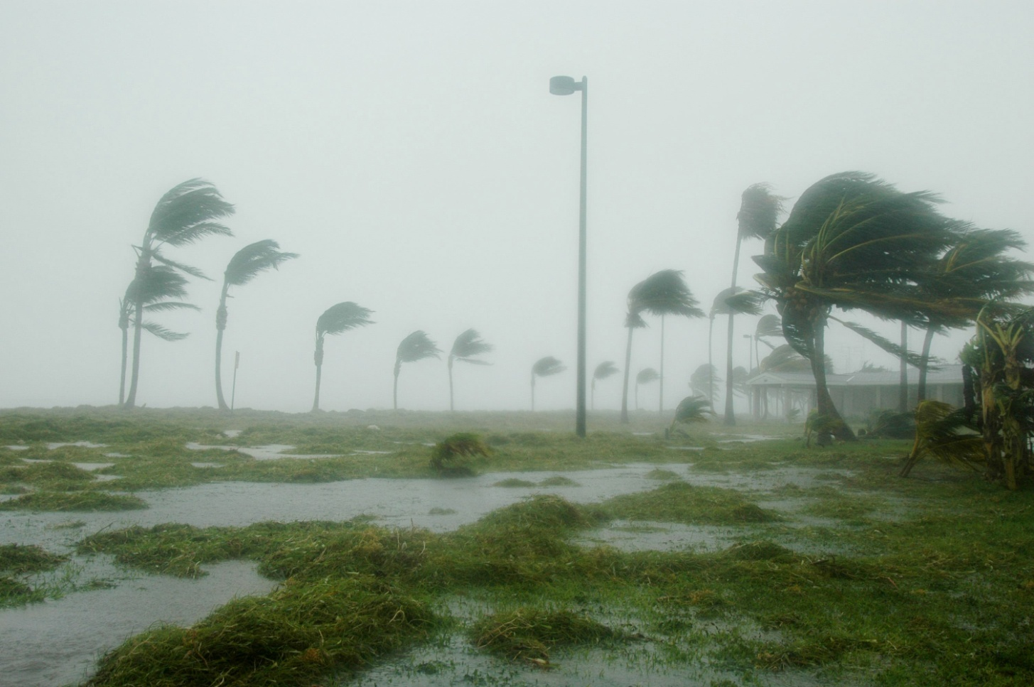
Module 2 – September 5 Landfall

Slide 20
Module 2 – September 5, 0600 hrs
The high surf and heavy rains arrive and flood the drinking water treatment plant − although submerged, the area around the drinking water treatment plant remains intact
Hurricane Mariana makes landfall as predicted and further floods the drinking water treatment plant, which has been evacuated
The power and landline telephone service is out throughout the region, and is expected to remain down for the next three days

Slide 21
Module 2 – September 5, 0600 hrs (cont.)
Cell phone service is unreliable as towers are down and thousands of people are trying to contact family members and friends
Debris blocks major and secondary roads and inhibits emergency work and delivery of supplies
Emergency responders focus on rescuing survivors from flooded areas and collapsed housing

Slide 22
Key Issues – Module 2
The wastewater utility’s radio repeater antenna is severely damaged during the hurricane, which is hampering staff’s ability to communicate in the field
Flood debris is piling in and around the utility pump stations and covering broken lines
Flooding at the water treatment plant is causing water seepage into SCADA control panels, and staff members fear that the plant’s SCADA system will be inoperable soon
Sand and debris is clogging portions of the collection system, causing sewage to back up into the streets
Notes:
Based on the information provided, encourage players to participate in a discussion concerning the issues raised in Module 2. Identify any critical issues, decisions, requirements or questions that should be addressed at this time.
The following questions are provided as suggested subjects that you may wish to address as the discussion progresses. These questions are not meant to constitute a definitive list of concerns to be addressed, nor is there a requirement to address every question.
[How will communications be handled to internal staff, to the public, to the business community and to elected and other government officials? How will this be impacted by power and phone service outages?]
[Considering that field staff is having difficulty communicating, what back-up communications or relay systems could you use if you lost radio service to the field?]
[What backup procedures does your utility have in place to operate without SCADA systems?]
[How can mutual aid and assistance be used at your facility during an incident for water supply or wastewater disposal?]
[What policies or guidelines do you have in place that govern acceptable outdoor working conditions for staff?]

Slide 23
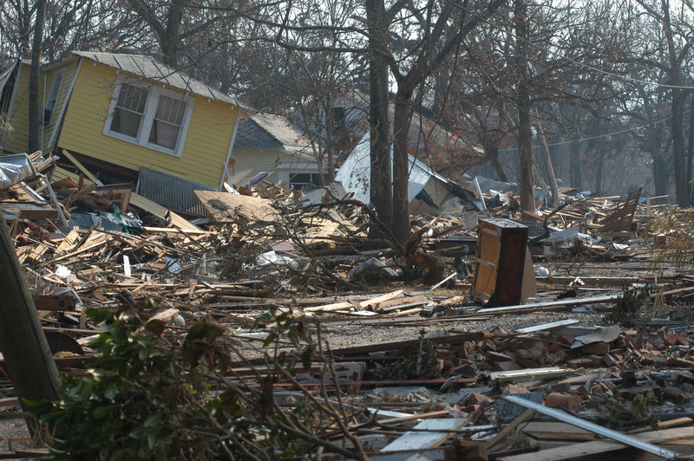
Module 3 – September 6 The Hurricane Passes

Slide 24
Module 3 – September 6, 1000 hrs
Drinking water utility staff stage generators and backup pumps, but soon determine that they need two additional pumps for high service distribution
Due to multiple sewer and water line breaks around the city, the safety of the drinking water is a major concern
Local and state laboratories are either heavily damaged or have staff who have been evacuated

Slide 25
Module 3 – September 6, 1000 hrs (cont.)
The wastewater plant, already partially submerged from the heavy rains, has lost three lift stations to hurricane-driven debris
The wastewater utility is also short-staffed and needs help from other emergency responders to remove the debris piled in and around the inoperable lift stations and multiple broken collection lines

Slide 26
Key Issues – Module 3
Debris management teams not under the control of the drinking water utility have inadvertently caused more damage to the distribution system by knocking over fire hydrants and valve boxes as they clear sand and debris from roadways
Staff levels at the wastewater treatment plant are very low, as many vacationing and evacuated employees are having difficulty returning due to roadblocks and road closures

Slide 27
Key Issues – Module 3
The wastewater utility is still partially under water, major collection lines (some gravity, some pressurized) have been broken and three lift stations are severely damaged
Washouts have caused water main and individual drinking water service breaks, and water pressure is low in some neighborhoods
Water sampling has been suspended due to the flooded conditions and danger to utility staff
Water samples are awaiting analysis, as both the local and state laboratories are not operable due to storm damage
Notes:
Based on the information provided, encourage players to participate in a discussion concerning the issues raised in Module 3. Identify any critical issues, decisions, requirements or questions that should be addressed at this time.
The following questions are provided as suggested subjects that you may wish to address as the discussion progresses. These questions are not meant to constitute a definitive list of concerns to be addressed, nor is there a requirement to address every question.
[How does your utility coordinate response with other responders? Specifically, how can your utility redirect the efforts of those causing additional damage to the system?]
[What procedures and/or provisions are in place to support staff with special needs (e.g., lost or damaged personal property, injured or killed family/friends, psychological impact from the devastation) due to the incident?]
[What procedures have been developed to address logistical support (e.g., food, shelter and equipment for responders) during this incident?]
[What facilities and/or activities are most critical and require immediate attention at the conclusion of response activities?]
[What additional resources (e.g., staff, heavy equipment and generators) would your utility need to repair damage and restore service? Where will they come from?]
[What procedures does your utility have for resuming water service after an incident? How is this impacted if laboratories around you are closed or overwhelmed with high sample volume?]

Slide 28
Action planning session post exercise
Action Planning Session
Post-Exercise “Hot Wash”

Slide 29
Review of exercise objectives
Review of Exercise Objectives
Explore and address cybersecurity challenges
Define or refine participants’ roles and responsibilities for managing the consequences of a cybersecurity incident, which should be reflected in their plans, policies and procedures and other preparedness elements currently in place or under development
Build relationships between utilities and stakeholders
Increase awareness of the damage that can be caused by a cybersecurity incident on a business or control system
Identify other needed enhancements related to training and exercises and other preparedness elements currently in place or under development
Notes:
Discuss each objective and corresponding outcome.

Slide 30
conclusion
Conclusion
Please turn in your notes from the Action Planning Session, your participant evaluation form and any additional comments you wish to share
This information will be used to develop an After Action Report and Improvement Plan

Slide 31
Closing remarks thank you for participating
Closing Remarks
Thank you for participating

