Slide 1
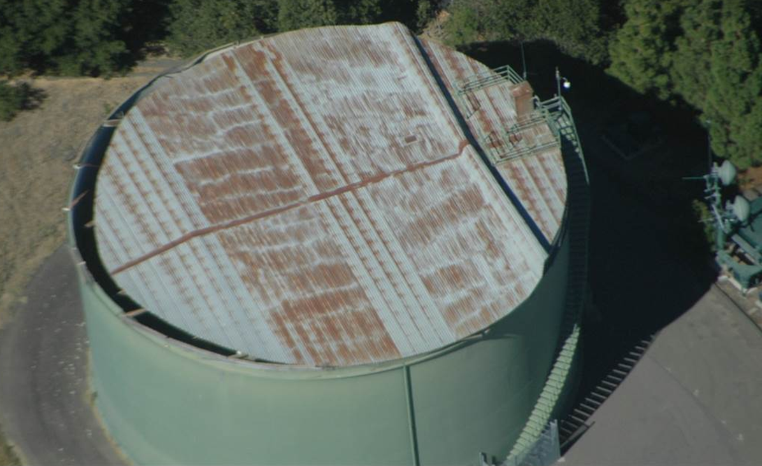
Earthquake scenario
Earthquake Scenario
Tabletop Exercise
Notes:
The Scenario Presentation is a multimedia presentation used by the facilitator during the tabletop exercise to present the material in the Situation Manual (SitMan). The Scenario Presentation is put together from and follows the same order as the SitMan. Most users will find it easier to develop the Scenario Presentation after they have finalized the SitMan.
All of the slides presented here may be modified as needed. For example, an Exercise Development Team (EDT) may decide not to include all or part of the slides presented here since the same information is already available to participants through their SitMan.
Facilitators are encouraged to use this “notes” section on each slide to incorporate additional material, such as follow-up questions or comments.

Slide 2
Tabletop Exercise
Welcome and introductions
Discuss agenda for the day
Review administrative details
Start the exercise

Slide 3
Welcome and Introductions
Name
Organization
Emergency response experience

Slide 4
Agenda
Review exercise materials and rules
Review scenario(s)
Break
Facilitated discussion period
Action planning session (“hot wash”)
Review and conclusion
Closing comments

Slide 5
Administrative Details
Location of emergency exits
Location of restrooms
Cell phone and pager management
Logging your time to fulfill training requirements
Sign-in sheet and participant evaluation form

Slide 6
Exercise Benefits:
Increase readiness in the event of an actual emergency
Provide a means to assess effectiveness of response plans and response capabilities
Serve as a training tool for response personnel and their involvement with other response agencies
Provide an opportunity to practice skills and improve individual performance in a non-threatening environment

Slide 7
Exercise Benefits: (cont.)
Require participants to network with each other and pre-plan decisions on resources
Identify planning conflicts or gaps
Identify resource needs and opportunities for sharing of resources
Clarify internal and external roles and responsibilities

Slide 8
Exercise Objectives:
At the conclusion of this exercise, participants should be able to do the following:
Define or refine participants’ roles and responsibilities for managing the consequences of an earthquake incident, which should be reflected in their plans, policies and procedures and other preparedness elements currently in place or under development
Build relationships between utilities and stakeholders
Notes:
8

Slide 9
Exercise Objectives: (cont.)
Determine neighboring utility water infrastructure capabilities and needs
Identify water infrastructure coordination requirements of state agencies operating under the appropriate Emergency Support Functions (ESFs)
Identify other needed enhancements related to training and exercises and other preparedness elements currently in place or under development
This session will not be a success unless you as a participant go back to your office and follow through
Notes:
9

Slide 10
Roles and Responsibilities:
Players respond to the situation presented based on expert knowledge of response procedures, current plans and procedures, and insights derived from training and experience
Observers observe the exercise but do not participate in the facilitated discussion period
Facilitators lead the exercise by presenting the scenario narrative and facilitating the discussion period and “hot wash” (Action planning session or review session)
Evaluators monitor the exercise, track accomplishments according to objectives and may ask questions

Slide 11
Exercise Rules:
This exercise will be held in an open, low-stress, no-fault environment − varying viewpoints, even disagreements, are expected
Respond to the scenario using your knowledge of current plans and capabilities (i.e., you may use only existing assets) and insights derived from your training
Decisions are not precedent setting and may not reflect your organization’s final position on a given issue − this exercise is an opportunity to discuss and present multiple options and possible solutions

Slide 12
Exercise Rules: (cont.)
Issue identification is not as valuable as suggestions and recommended actions that could improve [prevention, protection, mitigation, response or recovery] efforts − problem-solving efforts should be the focus
Assume there will be cooperation and support from other responders and agencies
The basis for discussion consists of the scenario narrative and modules, your experience, your understanding of your Emergency Response Plan (ERP), your intuition and other utility resources included as part of this material or that you brought with you
Treat the scenario as if it will affect your area

Slide 13
Action planning seesion
Action Planning Session:
Following the facilitated discussion period, the facilitator will lead an Action Planning Session, also known as a “hot wash”
Participants are encouraged to identify, discuss and prioritize next steps, actions, tasks and other follow-up activities
Identify additional collaborators if needed
Schedule a follow-up meeting

Slide 14
Cybersecurity scenario
Earthquake Scenario
Notes:
The Scenario Presentation is a multimedia presentation used by the facilitator during the tabletop exercise to present the material in the Situation Manual (SitMan). The Scenario Presentation is put together from and follows the same order as the SitMan. Most users will find it easier to develop the Scenario Presentation after they have finalized the SitMan.
All of the slides presented here may be modified as needed. For example, an Exercise Development Team (EDT) may decide not to include all or part of the slides presented here since the same information is already available to participants through their SitMan.
Facilitators are encouraged to use this “notes” section on each slide to incorporate additional material, such as follow-up questions or comments.

Slide 15
Background
The weather forecast predicts rain
Winds are from the west-southwest at 5-10 mph
The high for the day is forecast to be 70 degrees Fahrenheit

Slide 16
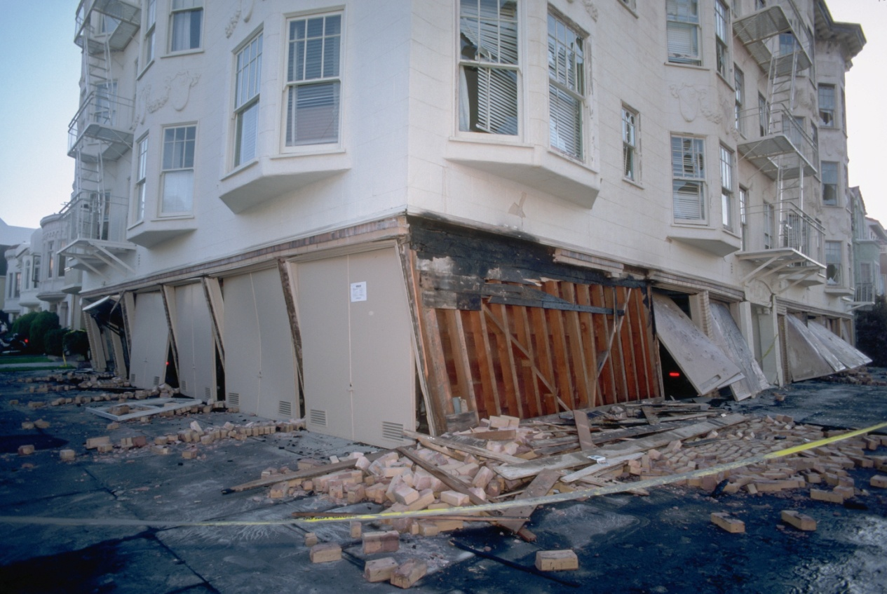
Module 1 – June 24 The Earthquake

Slide 17
Module 1 – June 24, 1415 hrs
Suddenly, the ground shakes violently
Seismologists at the regional Earthquake Data Center (EDC) measure the earthquake at 6.0 on the Richter scale
The EDC relays the earthquake data to the U.S. Geological Survey (USGS)
Two sizeable aftershocks of 4.7 and 4.5 occur within the first hour
More aftershocks are expected over the next 24 to 48 hours
Notes:
17

Slide 18
Module 1, – June 24, 1415 hrs (cont.)
Shortly, emergency sirens can be heard
The media broadcasts breaking news stories nationwide
Initial reports indicate serious damage and numerous human casualties are likely
Utility managers check that their staff is safe and accounted for
Communication is difficult with people working in the field
Notes:
18

Slide 19
Key Issues – Module 1
Utility emergency response team staff is quickly overwhelmed by the scale of the incident
Accessing needed help proves difficult due to limited phone lines and transportation routes
Sinkholes and large pools of water start to appear as a result of main breaks
Broken sewer lines cause sewage to flood low-lying areas and streets
Some areas experience electricity outages
Notes:
Based on the information provided, encourage players to participate in a discussion concerning the issues raised in Module 1. Identify any critical issues, decisions, requirements or questions that should be addressed at this time.
The following questions are provided as suggested subjects that you may wish to address as the discussion progresses. These questions are not meant to constitute a definitive list of concerns to be addressed, nor is there a requirement to address every question.
[What, if any, existing earthquake preparedness measures does your utility have in place? For example, what plans do you have for safeguarding supplies and equipment or obtaining them from outside of the impacted area?]
[What further earthquake proofing measures could be implemented?]
[What procedures have been developed to assess the situation?]
[What are some initial actions that will be taken to support the response?]
[How will communications be handled to internal staff, to the public and to officials? How will these procedures be carried out in the event of electricity or phone service interruptions?]
[Should the Incident Command System (ICS) be established at the utilities? When should it be established? How does your ICS structure fit into the larger response structure established to manage the earthquake? What are your initial incident objectives? Where will the utilities’ Incident Command Posts be located?]

Slide 20
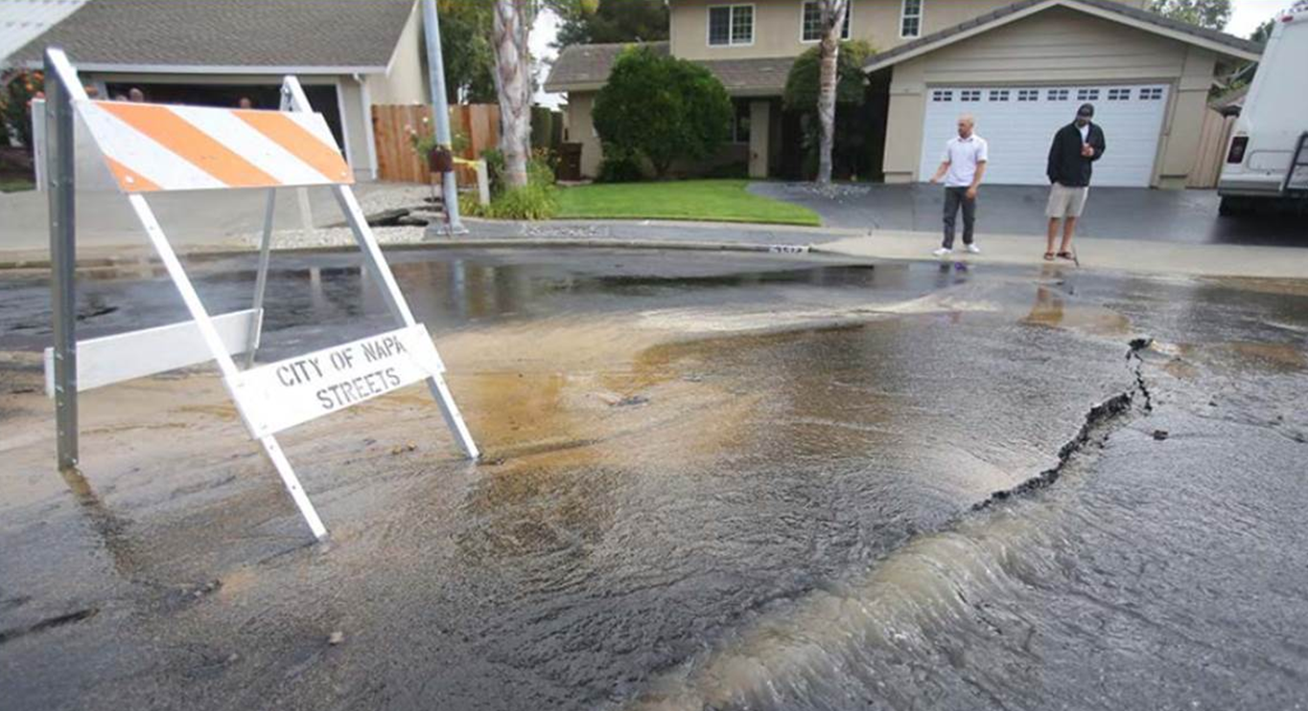
Module 2 – June 24 The Aftermath

Slide 21
Module 2 – June 24, 1815 hrs
There is severe structural damage along two portions of the primary roadways
Damage in the southeast quadrant of the city has blocked all traffic in and out
Heavy damage in the northeast section has caused gridlock in the business district
Debris is blocking many of the roads and major highways − alternate routes must be used
Hospitals are overwhelmed with citizens seeking medical treatment and looking for family members and friends

Slide 22
Module 2, – June 24, 1815 hrs (cont.)
Initial reports show that at least 150 people have been killed and there are more than 5,000 injured people
Power and phone lines are down and 60 percent of the city is without electricity and phone service, including cell coverage
There are numerous gas leaks and some have caused explosions and fires at locations across the city

Slide 23
Module 2, – June 24, 1815 hrs (cont.)
Water and sewer line leaks worsen as the day goes on − utilities predict that damage is extensive, but most is not yet apparent
The governor learned of the earthquake during a planning committee meeting at the Capitol − she declares a state of emergency and immediately contacts FEMA to request a federal Stafford Act Disaster Declaration
The governor is organizing an initial regional damage assessment and has requested reports from each affected county

Slide 24
Module 2 – June 24, 1815 hrs (cont.)
National Guard resources have been requested to provide emergency services
Water and wastewater utilities do not have sufficient staffing to handle the large number of repairs currently necessary, and emergency response and management agencies are occupied with more acute life safety emergencies

Slide 25
Module 2 – June 24, 1815 hrs (cont.)
The state’s Emergency Management Agency is fully functional and the state Emergency Operations Center (EOC) is activated
An Incident Command System (ICS) has been established by local responders − FEMA regional personnel are working with local emergency management personnel

Slide 26
Key Issues – Module 2
The local water utility identifies major leaks in two underground concrete water storage reservoirs located in the city − that, combined with localized flooding from broken water and sewer mains, is likely to flood basements and low-level structures
Since the in-city reservoirs contain finished drinking water, the majority of the city will also be without drinking water service and water pressure will be low in serviceable areas

Slide 27
Key Issues – Module 2 (cont.)
The wastewater plant has been shut down for repairs − the treatment process is disrupted due to major structural damage at the Southeast Treatment Plant
Plant shutdown may cause significant backup and raw sewage spills or force the operators to bypass some or all treatment processes
Residents with drinking water service are concerned about drinking tap water and there are complaints about discoloration and floating particles

Slide 28
Key Issues – Module 2 (cont.)
Several distribution lines are damaged and will require repair and disinfection
Proximity to sewer line breaks also poses a more extensive contamination concern − locating some of these breaks may be delayed due to low water pressure
The rural wastewater treatment plant just outside of the city lost power to automated treatment and pumping systems and is in need of additional generators as well as personnel to run plant operations manually
Notes:
Based on the information provided, participate in the discussion concerning the issues raised in Module 2. Identify any critical issues, decisions, requirements or questions that should be addressed at this time.
The following questions are provided as suggested subjects that you may wish to address as the discussion progresses. These questions are not meant to constitute a definitive list of concerns to be addressed, nor is there a requirement to address every question.
[How do you determine if an advisory or public notification (such as boil water or do not use) needs to be issued for this incident? How would this occur without power and if normal communication media such as TV and radio outlets are unavailable? What alternative resources could be available to issue an advisory?]
[What additional resources (e.g., staff, heavy equipment and generators) would the wastewater utility need to prevent additional discharges of raw sewage into receiving waters as well as into residential and commercial districts?]
[What process exists to prioritize repairs and drinking water service when supplies, staff and potable water are limited? For instance, will your utility prioritize repairing water lines that provide fire protection services to dense areas or service to critical customers such as hospitals above other water mains?]
[How will the utility manage their staff to avoid exhaustion? How will they bring in “reinforcements”?]
[What procedures have been developed to address logistical support (i.e., food, shelter and equipment for utility and mutual aid workers) during this incident?]
[Security systems at the utility are likely to be compromised or not functioning after an incident such as this. How will the utility ensure the security of its facilities?]

Slide 29
Action planning session post exercise
Action Planning Session
Post-Exercise “Hot Wash”

Slide 30
Review of exercise objectives
Review of Exercise Objectives
Explore and address cybersecurity challenges
Define or refine participants’ roles and responsibilities for managing the consequences of a cybersecurity incident, which should be reflected in their plans, policies and procedures and other preparedness elements currently in place or under development
Build relationships between utilities and stakeholders
Increase awareness of the damage that can be caused by a cybersecurity incident on a business or control system
Identify other needed enhancements related to training and exercises and other preparedness elements currently in place or under development
Notes:
Discuss each objective and corresponding outcome.

Slide 31
conclusion
Conclusion
Please turn in your notes from the Action Planning Session, your participant evaluation form and any additional comments you wish to share
This information will be used to develop an After Action Report and Improvement Plan

Slide 32
Closing remarks thank you for participating
Closing Remarks
Thank you for participating

