Slide 1
Distribution System
Distribution System Contamination Scenario
Tabletop Exercise
Notes:
The Scenario Presentation is a multimedia presentation used by the facilitator during the tabletop exercise to present the material in the Situation Manual (SitMan). The Scenario Presentation is put together from and follows the same order as the SitMan. Most users will find it easier to develop the Scenario Presentation after they have finalized the SitMan.
All of the slides presented here may be modified as needed. For example, an Exercise Development Team (EDT) may decide not to include all or part of the slides presented here since the same information is already available to participants through their SitMan.
Facilitators are encouraged to use this “notes” section on each slide to incorporate additional material, such as follow-up questions or comments.

Slide 2
Tabletop Exercise
Welcome and introductions
Discuss agenda for the day
Review administrative details
Start the exercise

Slide 3
Welcome and Introductions
Name
Organization
Emergency response experience

Slide 4
Agenda
Review exercise materials and rules
Review scenario(s)
Break
Facilitated discussion period
Action planning session (“hot wash”)
Review and conclusion
Closing comments

Slide 5
Administrative Details
Location of emergency exits
Location of restrooms
Cell phone and pager management
Logging your time to fulfill training requirements
Sign-in sheet and participant evaluation form

Slide 6
Exercise Benefits:
Increase readiness in the event of an actual emergency
Provide a means to assess effectiveness of response plans and response capabilities
Serve as a training tool for response personnel and their involvement with other response agencies
Provide an opportunity to practice skills and improve individual performance in a non-threatening environment

Slide 7
Exercise Benefits: (cont.)
Require participants to network with each other and pre-plan decisions on resources
Identify planning conflicts or gaps
Identify resource needs and opportunities for sharing of resources
Clarify internal and external roles and responsibilities

Slide 8
Exercise Objectives:
At the conclusion of this exercise, participants should be able to do the following:
Define or refine participants’ roles and responsibilities for managing the consequences of a distribution system contamination incident, which should be reflected in their plans, policies and procedures and other preparedness elements currently in place or under development
Build relationships between utilities and stakeholders
Notes:
8

Slide 9
Exercise Objectives: (cont.)
Determine neighboring utility water infrastructure capabilities and needs
Identify other needed enhancements related to training and exercises and other preparedness elements currently in place or under development
This session will not be a success unless you as a participant go back to your office and follow through
Notes:
9

Slide 10
Roles and Responsibilities:
Players respond to the situation presented based on expert knowledge of response procedures, current plans and procedures and insights derived from training and experience
Observers observe the exercise but do not participate in the facilitated discussion period
Facilitators lead the exercise by presenting the scenario narrative and facilitating the discussion period and “hot wash” (Action planning session or review session)
Evaluators monitor the exercise, track accomplishments according to objectives and may ask questions

Slide 11
Exercise Rules:
This exercise will be held in an open, low-stress, no-fault environment − varying viewpoints, even disagreements, are expected
Respond to the scenario using your knowledge of current plans and capabilities (i.e., you may use only existing assets) and insights derived from your training
Decisions are not precedent setting and may not reflect your organization’s final position on a given issue − this exercise is an opportunity to discuss and present multiple options and possible solutions

Slide 12
Exercise Rules: (cont.)
Issue identification is not as valuable as suggestions and recommended actions that could improve [prevention, protection, mitigation, response or recovery] efforts − problem-solving efforts should be the focus
Assume there will be cooperation and support from other responders and agencies
The basis for discussion consists of the scenario narrative and modules, your experience, your understanding of your Emergency Response Plan (ERP), your intuition and other utility resources included as part of this material or that you brought with you
Treat the scenario as if it will affect your area

Slide 13
Action Planning Session
Action Planning Session:
Following the facilitated discussion period, the facilitator will lead an Action Planning Session, also known as a “hot wash”
Participants are encouraged to identify, discuss and prioritize next steps, actions, tasks and other follow-up activities
Identify additional collaborators if needed
Schedule a follow-up meeting

Slide 14
Cybersecurity scenario
Distribution System Contamination Scenario

Slide 15
Module 1 – May 27 Contamination is Observed

Slide 16
Module 1 – May 27, 0700 hrs
The customer service department of the town’s water utility receives odor complaints from several local residents of the Buckhall neighborhood
The complaints are coming from residents on different streets − customers say their water smells skunk-like
An operator is dispatched to investigate and obtain samples from hydrants and/or residential buildings − once on site, the operator notices a strong, skunk-like smell in the samples
Notes:
16

Slide 17
Key Issues – Module 1
The origins of the taste and odor complaint calls are within a four-block radius
The area where taste and odor complaints are coming from is mostly residential - businesses include a florist, a specialty foods store and a few other small retailers
The utility uses free chlorine as the residual disinfectant
Notes:
Based on the information provided, encourage players to participate in a discussion concerning the issues raised in Module 1. Identify any critical issues, decisions, requirements or questions that should be addressed at this time.
The following questions are provided as suggested subjects that you may wish to address as the discussion progresses. These questions are not meant to constitute a definitive list of concerns to be addressed, nor is there a requirement to address every question.
[Who would the customer service department notify within your utility of a reported taste or odor complaint? What procedures and protocols does your utility follow during an incident like this?]
[In addition to collecting samples, what other initial actions would you initiate at this time?]
[What would your operator do when they notice the odor coming from the water when samples are collected?]
[What are the worker safety considerations during response to this type of incident?]
[Are any notifications made to agencies outside of your utility?]
[Would any public notification be made at this time? If so, to whom would this notification go and what would the notification advise? What procedures, protocols and templates exist at your utility for public notification?]

Slide 18
Module 2 – May 27 Complaints Continue

Slide 19
Module 2 – May 27, 0900 hrs
The local health department notes several unusual calls from the Buckhall neighborhood
Callers are complaining of a skunk or garlic-like odor in the tap water, and some are also reporting feeling mild nausea and headache from the odor

Slide 20
Key Issues – Module 2
The jurisdiction of the health department is entirely within the utility’s service area and covers approximately 80% of the service area
The local health department has key information that the utility would want to know
Customer complaints continue to come into the utility from the Buckhall neighborhood
Notes:
Based on the information provided, encourage players to participate in a discussion concerning the issues raised in Module 2. Identify any critical issues, decisions, requirements or questions that should be addressed at this time.
The following questions are provided as suggested subjects that you may wish to address as the discussion progresses. These questions are not meant to constitute a definitive list of concerns to be addressed, nor is there a requirement to address every question.
[What actions are taken by the local health department? What working relationship has your utility established with your local health department?]
[What established procedures would your local health department use to investigate the potential exposures?]
[Who would your local health department notify and what information would it provide?]
[What actions would your utility take if notified by the local health department of potential exposures that may be due to contaminated water?]

Slide 21
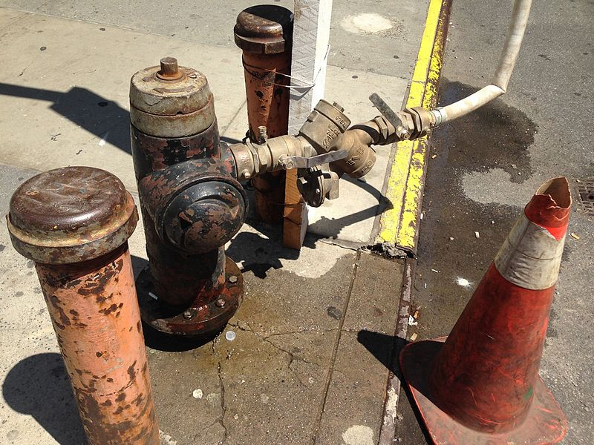
Module 3 – May 27 The Contamination Source is Identified

Slide 22
Module 3 – May 27, 1100 hrs
Through interviews, the utility operator and supervisor learn that the odor reminds residents of a smell they detect after lawn care workers have been by
Both an ABC Lawn Care truck and a Fly-by-Night Lawn Care truck were spotted connected to fire hydrants early in the morning
The companies care for several yards in the neighborhood, and ABC Lawn Care has a contract to maintain the town’s public spaces
No hydrant permit has been issued for Fly-by-Night Lawn Care in the last two weeks

Slide 23
Module 3 – May 27, 1100 hrs (cont.)
A Fly-by-Night Lawn Care employee admits he did not obtain a permit to use the hydrant in Buckhall, and connected to it without a fire hydrant meter assembly
He did use backflow prevention, but the device has not been maintained or inspected
The worker used the hydrant to add water to a 300-gallon tank to dilute malathion
Unintentional backflow is probably the cause for the odor complaints in the neighborhood

Slide 24
Key Issues – Module 3
29 residences and six businesses were impacted by the contaminant
Receiving a definitive analytical result for malathion in drinking water may take some time
There are color change tickets that can screen for organophosphates
Any concentrated malathion should be handled by HazMat teams, as skin contact can be hazardous
Notes:
Based on the information provided, encourage players to participate in a discussion concerning the issues raised in Module 3. Identify any critical issues, decisions, requirements or questions that should be addressed at this time.
The following questions are provided as suggested subjects that you may wish to address as the discussion progresses. These questions are not meant to constitute a definitive list of concerns to be addressed, nor is there a requirement to address every question.
[What investigative and response procedures are in place at your utility? How can these be changed as the situation evolves?]
[How are these procedures modified by the holiday weekend? What backup staff is in place?]
[What other response actions would your utility take now?]
[Given that your local public health department is already involved, how would your utility coordinate investigation and response actions with the local health department?]
[What water use advisory would your utility issue?]
[What actions, operational changes and water use advisories would your utility implement based on rapid field testing results?]
[How would water customers be notified and updated as your utility receives more information about the contamination that has occurred?]
[What utility response partner agencies need to be notified and involved in this incident?]
[What sampling and analysis procedures are in place at your utility? How are they modified when sampling for unknown contaminants? What laboratories (in addition to an in-house utility laboratory) do you rely on for emergency sampling and analysis?]
[Which laboratory would analyze the samples? Would they analyze a sample for an unknown contaminant? Are contracts in place for rapid turn-around analysis?]

Slide 25
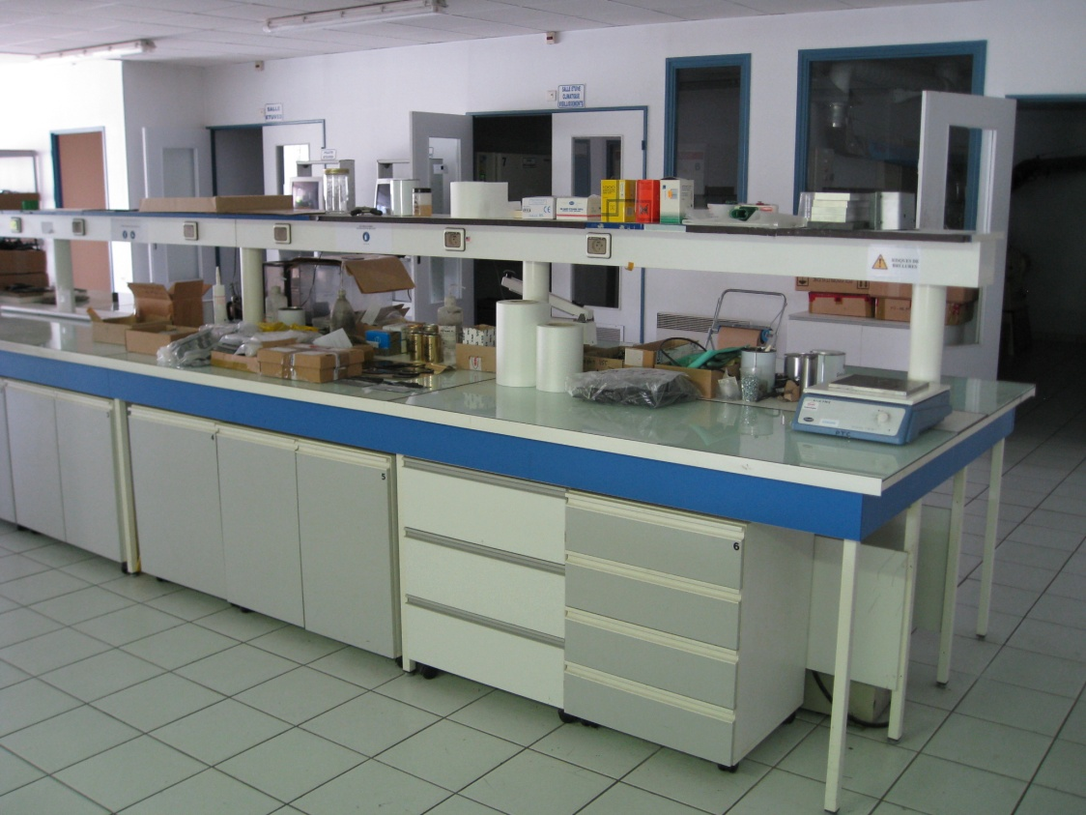
Module 4 – May 28 The Contamination Extent is Determined

Slide 26
Module 4 – May 28, 1400 hrs
Laboratory results reveal concentrations of malathion at up to 10.0 mg/L in the impacted area
Malathion is a common insecticide
According to EPA, the following levels of malathion in drinking water are not expected to cause harmful health effects:
0.2 mg/L for 1 day, 10 days, or longer-term exposure for children
0.1 mg/L for lifetime exposure of adults

Slide 27
Module 4 – May 28, 1400 hrs (cont.)
The utility believes the contamination has been isolated to a five-block area of the Buckhall neighborhood
A flushing plan is being developed to purge the malathion from the affected portion of the distribution system

Slide 28
Key Issues – Module 4
Malathion exhibits a “stickiness” to copper and iron pipes
Malathion does react with free chlorine − Malaoxon is produced but it degrades rapidly
Flushing of water from the system without additional treatment may pose a threat to the environment due to malathion’s toxicity to wildlife
Notes:
Based on the information provided, encourage players to participate in a discussion concerning the issues raised in Module 4. Identify any critical issues, decisions, requirements or questions that should be addressed at this time.
The following questions are provided as suggested subjects that you may wish to address as the discussion progresses. These questions are not meant to constitute a definitive list of concerns to be addressed, nor is there a requirement to address every question.
[What resources does your utility use to find information regarding contaminants for which no maximum contaminant level exists? Is your utility familiar with or registered to use EPA’s Water Contaminant Information Tool (WCIT)?]
[Who would your utility work with to evaluate the potential health effects of malathion exposure? Who would establish “safe” concentrations of the contaminant in water?]
[What flushing procedures does your utility have? With whom would you consult to potentially modify them for this incident?]
[What measures would your utility take to ensure that affected customers within the isolation zone have access to alternate drinking water and fire protection?]

Slide 29
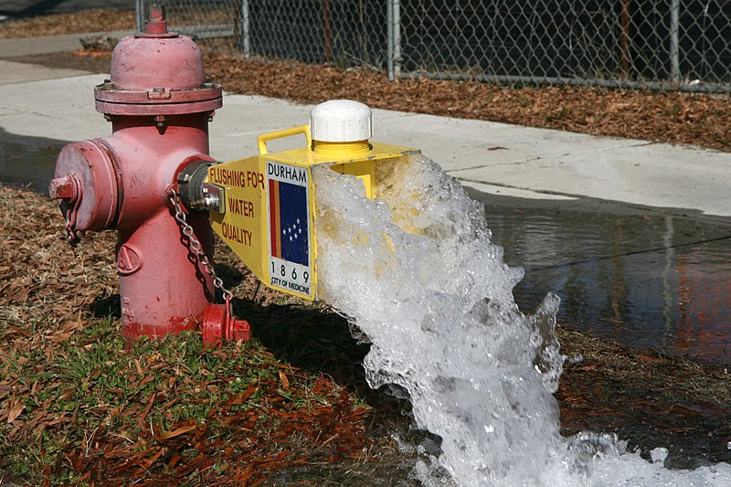
Module 5 – May 29 The Contamination is Remediated

Slide 30
Module 5 – May 29, 0800 hrs
The utility implements a flushing protocol to remove the affected water from the distribution system
The mains will be flushed for three to six pipe volumes, but some malathion may “stick” to pipe walls
Internal water fixtures of the impacted residences and buildings will also need flushing
Water using appliances (e.g., ice and coffee makers) must be replaced

Slide 31
Key Issues – Module 5
All residences and businesses have been notified of the identity and extent of the contamination
The entire plumbing systems of several residences and businesses were contaminated during the incident
Untreated water containing malathion that is removed from the system via flushing may pose a threat to wildlife
Notes:
Based on the information provided, encourage players to participate in a discussion concerning the issues raised in Module 5. Identify any critical issues, decisions, requirements or questions that should be addressed at this time.
The following questions are provided as suggested subjects that you may wish to address as the discussion progresses. These questions are not meant to constitute a definitive list of concerns to be addressed, nor is there a requirement to address every question.
[How will the flushed water be handled? Can it be discharged to the sanitary or combined sewer? Will treatment, including dechlorination, be required prior to discharge?]
[Who can your utility turn to for technical expertise regarding malathion? Where can your utility turn to locate additional staff to assist with the flushing operation?]
[What are some ways your utility could find the additional treatment chemicals if needed to properly dispose of the flushed, contaminated water?]
[How will the wastewater treatment plant be engaged in decisions about how to handle the flushed water?]
[How would your utility be cleared for resumption of normal operation and use by the public?]
[What course of action would be considered if the contaminant remained in the distribution system at unacceptable levels after the extensive flushing (i.e., because it adhered to pipe walls and plumbing fixtures)?]

Slide 32
Action planning session post exercise
Action Planning Session
Post-Exercise “Hot Wash”

Slide 33
Review of exercise objectives
Review of Exercise Objectives
Explore and address cybersecurity challenges
Define or refine participants’ roles and responsibilities for managing the consequences of a cybersecurity incident, which should be reflected in their plans, policies and procedures and other preparedness elements currently in place or under development
Build relationships between utilities and stakeholders
Increase awareness of the damage that can be caused by a cybersecurity incident on a business or control system
Identify other needed enhancements related to training and exercises and other preparedness elements currently in place or under development
Notes:
Discuss each objective and corresponding outcome.

Slide 34
conclusion
Conclusion
Please turn in your notes from the Action Planning Session, your participant evaluation form and any additional comments you wish to share
This information will be used to develop an After Action Report and Improvement Plan

Slide 35
Closing remarks thank you for participating
Closing Remarks
Thank you for participating

