Slide 1
Pandemic flue scenario
Black Sky Scenario
Tabletop Exercise
Notes:
The Scenario Presentation is a multimedia presentation used by the facilitator during the tabletop exercise to present the material in the Situation Manual (SitMan). The Scenario Presentation is put together from and follows the same order as the SitMan. Most users will find it easier to develop the Scenario Presentation after they have finalized the SitMan.
All of the slides presented here may be modified as needed. For example, an Exercise Development Team (EDT) may decide not to include all or part of the slides presented here since the same information is already available to participants through their SitMan.
Facilitators are encouraged to use this “notes” section on each slide to incorporate additional material, such as follow-up questions or comments.

Slide 2
Tabletop Exercise
Welcome and introductions
Discuss agenda for the day
Review administrative details
Start the exercise

Slide 3
Welcome and Introductions
Name
Organization
Emergency response experience

Slide 4
Agenda
Review exercise materials and rules
Review scenario(s)
Break
Facilitated discussion period
Action planning session (“hot wash”)
Review and conclusion
Closing comments

Slide 5
Administrative Details
Location of emergency exits
Location of restrooms
Cell phone/pager management
Logging your time to fulfill training requirements
Sign-in sheet and participant evaluation form

Slide 6
Exercise Benefits:
Increase readiness in the event of an actual emergency
Provide a means to assess effectiveness of response plans and response capabilities
Serve as a training tool for response personnel and their involvement with other response agencies
Provide an opportunity to practice skills and improve individual performance in a non-threatening environment

Slide 7
Exercise Benefits: (cont.)
Require participants to network with each other and pre-plan decisions on resources
Identify planning conflicts or gaps
Identify resource needs and opportunities for sharing of resources
Clarify internal and external roles and responsibilities

Slide 8
Exercise Objectives:
At the conclusion of this exercise, participants should be able to do the following:
Define or refine participants’ roles and responsibilities for managing the consequences of a black sky incident, which should be reflected in their plans, policies and procedures and other preparedness elements currently in place or under development
Build relationships between utilities and stakeholders
Notes:
8

Slide 9
Exercise Objectives: (cont.)
Determine neighboring utility water infrastructure capabilities and needs
Identify other needed enhancements related to training and exercises and other preparedness elements currently in place or under development
This session will not be a success unless you as a participant go back to your office and follow through
Notes:
9

Slide 10
Roles and Responsibilities:
Players respond to the situation presented based on expert knowledge of response procedures, current plans and procedures and insights derived from training and experience
Observers observe the exercise but do not participate in the facilitated discussion period
Facilitators lead the exercise by presenting the scenario narrative and facilitating the discussion period and “hot wash” (Action planning session or review session)
Evaluators monitor the exercise, track accomplishments according to objectives and may ask questions

Slide 11
Exercise Rules:
This exercise will be held in an open, low-stress, no-fault environment − varying viewpoints, even disagreements, are expected
Respond to the scenario using your knowledge of current plans and capabilities (i.e., you may use only existing assets) and insights derived from your training
Decisions are not precedent setting and may not reflect your organization’s final position on a given issue − this exercise is an opportunity to discuss and present multiple options and possible solutions

Slide 12
Exercise Rules: (cont.)
Issue identification is not as valuable as suggestions and recommended actions that could improve [prevention, protection, mitigation, response or recovery] efforts − problem-solving efforts should be the focus
Assume there will be cooperation and support from other responders and agencies
The basis for discussion consists of the scenario narrative and modules, your experience, your understanding of your Emergency Response Plan (ERP), your intuition and other utility resources included as part of this material or that you brought with you
Treat the scenario as if it will affect your area

Slide 13
Action Planning Session
Action Planning Session:
Following the facilitated discussion period, the facilitator will lead an Action Planning Session, also known as a “hot wash”
Participants are encouraged to identify, discuss and prioritize next steps, actions, tasks and other follow-up activities
Identify additional collaborators if needed
Schedule a follow-up meeting

Slide 14
Cybersecurity scenario
Black Sky Scenario

Slide 15
Background
The definition of a “black sky” or long-duration power outage affecting a large geographic area can vary but generally refers to a power outage lasting 30 days or longer
A power outage of this magnitude may be the result of a natural disaster, accident, terrorist act, or significant cyber incident
This scenario does not describe the cause of the power outage
Players will focus on the water sector response to and recovery from the power outage

Slide 16
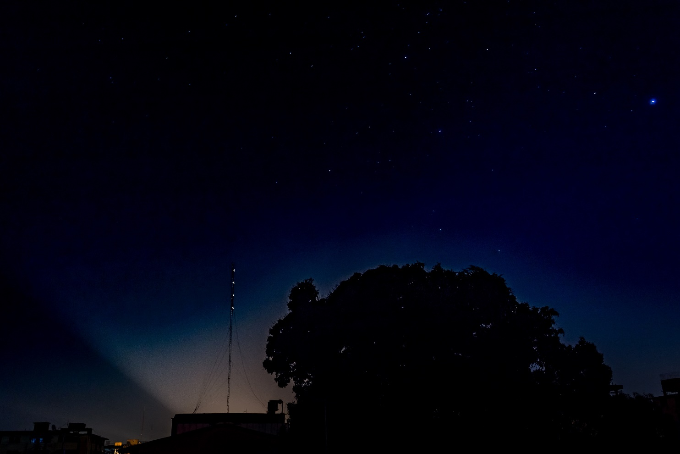
Module 1 – First Four Hours

Slide 17
Key Issues – Module 1
All power in the area is lost without warning. Initial reports indicate that the outage is widespread, impacting multiple counties
Many cell towers continue to operate on backup power, but mobile networks begin to fail due to overload
Notes:
Based on the information provided, encourage players to participate in a discussion concerning the issues raised in Module 1. Identify any critical issues, decisions, requirements or questions that should be addressed at this time.
The following questions are provided as suggested subjects that you may wish to address as the discussion progresses. These questions are not meant to constitute a definitive list of concerns to be addressed, nor is there a requirement to address every question.
Water/Wastewater Utility
[Does your utility have emergency power?]
[In administration buildings?]
[For treatment and distribution?]
[Does your utility have system pressure?]
[Is your utility delivering water?]
[Is your utility collecting wastewater?]
[What are your utility’s first three notifications?]
[What are your utility’s security concerns?]
[How is your utility communicating with customers and personnel?]
[Do processes or procedures exist to guide your actions, and if not, which ones would be helpful to develop?]
Electric/Gas Utility
[Does your utility have emergency power?]
[In administration buildings?]
[Is your utility delivering electricity/gas anywhere?]
[What are your utility’s first three notifications?]
[What are your utility’s security concerns?]
[How is your utility communicating with customers and personnel?]
Emergency Management Agency (EMA)
[Does your EMA have emergency power?]
[At the Emergency Operations Center (EOC)?]
[In other EMA facilities/field offices?]
[What are your first three notifications?]
[How is the EMA communicating with utilities, the public?]

Slide 18
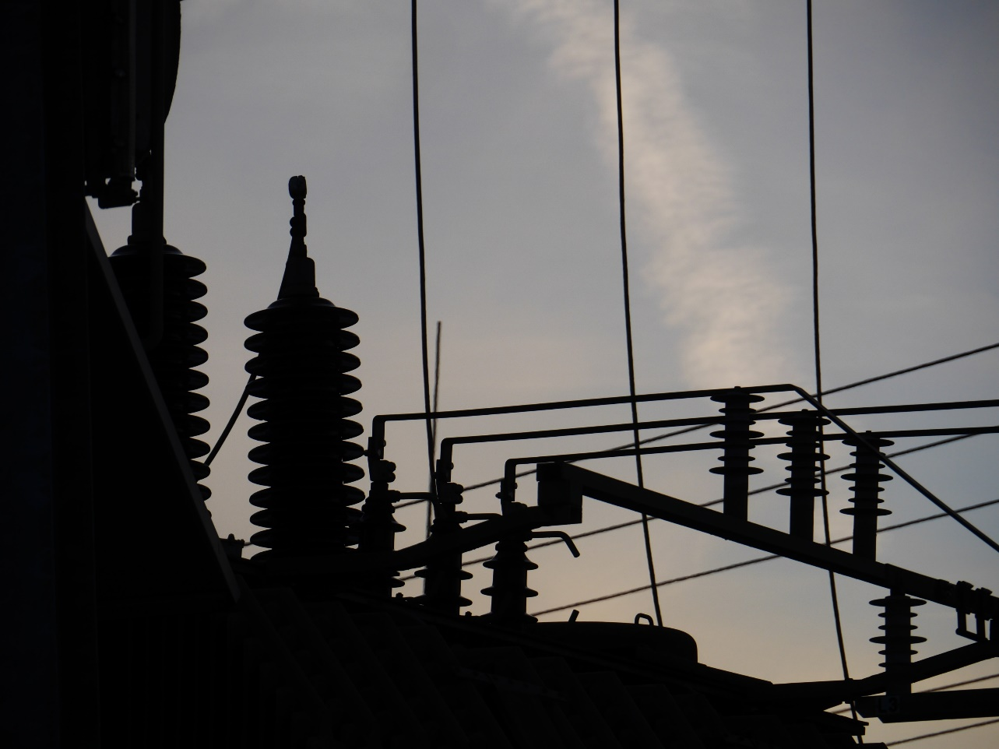
Module 2 – Twenty-Four Hours

Slide 19
Key Issues – Module 2
Electric utilities are informing the media and the public that they do not have a time estimate for when power will be restored
Fuel suppliers are unreachable by phone and email
Notes:
Based on the information provided, encourage players to participate in a discussion concerning the issues raised in Module 2. Identify any critical issues, decisions, requirements or questions that should be addressed at this time.
The following questions are provided as suggested subjects that you may wish to address as the discussion progresses. These questions are not meant to constitute a definitive list of concerns to be addressed, nor is there a requirement to address every question.
[Which sectors should be the highest priority for power restoration and how is this determined?]
[Do prioritized plans already exist?]
[Would prioritization change for a short-term versus a long-term event?]
[Which water sector facilities should be the highest priority?]
Has your utility prioritized operations or conducted a critical facility assessment? What essential operations can you maintain at minimum levels and for how long (e.g., maintaining minimum pressure, processing wastewater)?]
[Do electric utilities have an inventory of these facilities?]
[What regular coordination activities does your utility engage in with electric utilities?]
[Who are your water and wastewater utility’s critical customers?]
[What level of service are you providing critical customers?]
[How are you communicating with critical customers?]
[When are EOCs activated?]
[What is the role of local emergency management and elected officials in power restoration prioritization with the electrical utilities?]
[What is the role of the primacy agency in power restoration prioritization?]
[Do they or should they coordinate with their energy counterparts at the state level?]
[Is your utility communicating with your power provider to find out when service is expected to be restored?]
[What other information from your power provider do you want to know?]
[Are there alternative means of contacting your power provider if landlines, cell phones, and email are down?]
[What fuel types are needed to run utility generators?]
[How long can your utility operate on emergency/back-up power with the fuel you have on-site?]
[Is your fuel supplier prepared to provide fuel during an extended regional power outage?]
[Is the fuel prioritized?]
[Has your utility planned for how long generators can run continuously before being taken offline for regular maintenance?]
[What message will your utility communicate to the public about water and wastewater at this point?]
[How will you communicate messages to customers and the media?]
[Can the EMA assist the water utilities in other ways?]
[How does emergency management prioritize who gets a generator and when?]
[What concerns do public health agencies have?]
[At the residential level (e.g., in-home sanitation and hygiene)?]
[At the institutional level (e.g., hospitals, schools)?]
[Are public health agencies in communication/coordination with water and wastewater utilities?]
[What is the message from public health agencies to the public?]

Slide 20
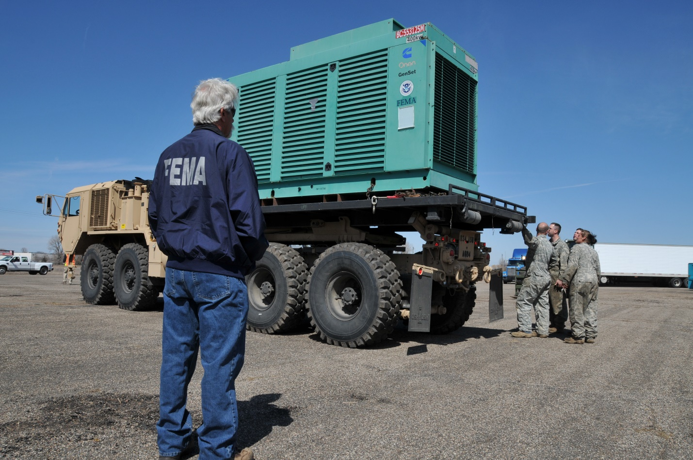
Module 3 – Four Days

Slide 21
Key Issues – Module 3
Local water and wastewater utilities are both facing moderate personnel shortages as a result of personnel that are unable or unwilling to come to work
Electric utilities are publicly stating that they expect the outage to continue for several more days
Many cell towers have exhausted fuel for backup power and are offline
Notes:
Based on the information provided, encourage players to participate in a discussion concerning the issues raised in Module 3. Identify any critical issues, decisions, requirements or questions that should be addressed at this time.
The following questions are provided as suggested subjects that you may wish to address as the discussion progresses. These questions are not meant to constitute a definitive list of concerns to be addressed, nor is there a requirement to address every question.
[What are the minimum staffing levels needed to provide water and wastewater services at your utility if some employees are unable or unwilling to come to work? What cross-training strategies can be employed to help fill emergency staffing needs?]
[What are your procedures for ensuring that critical employees are available to support operations for an extended emergency?]
[If there are gasoline shortages, what procedures do you have to encourage carpooling, providing fuel to employees for commuting or having employees shelter-at-work?]
[Who maintains your utility’s generators? What emergency contract provisions are in place?]
[Does your utility have a fuel system maintenance plan?]
[What is the longest amount of time your utility estimates that it can deliver “essential” services assuming no new fuel or treatment chemicals are available for two weeks?]
[If your water utility is unable to provide services, who has primary responsibility for arranging for alternate drinking water and wastewater services?]
[Does your utility need to update any advisories or notifications to the public?]
[How is your utility communicating internally and externally?]
[Is your utility considering leveraging mutual aid support for personnel, equipment and supplies (e.g., through WARN?]
[What are the electrical utility’s priorities at this point?]
[How do electric utilities trying to restore power depend on water services?]
[Are critical customers prioritized for power restoration (e.g., water utilities, hospitals, fire departments, law enforcement)?]
[Are fuel suppliers prioritizing deliveries to critical customers (e.g., water utilities, hospitals, fire departments, and law enforcement)?]

Slide 22
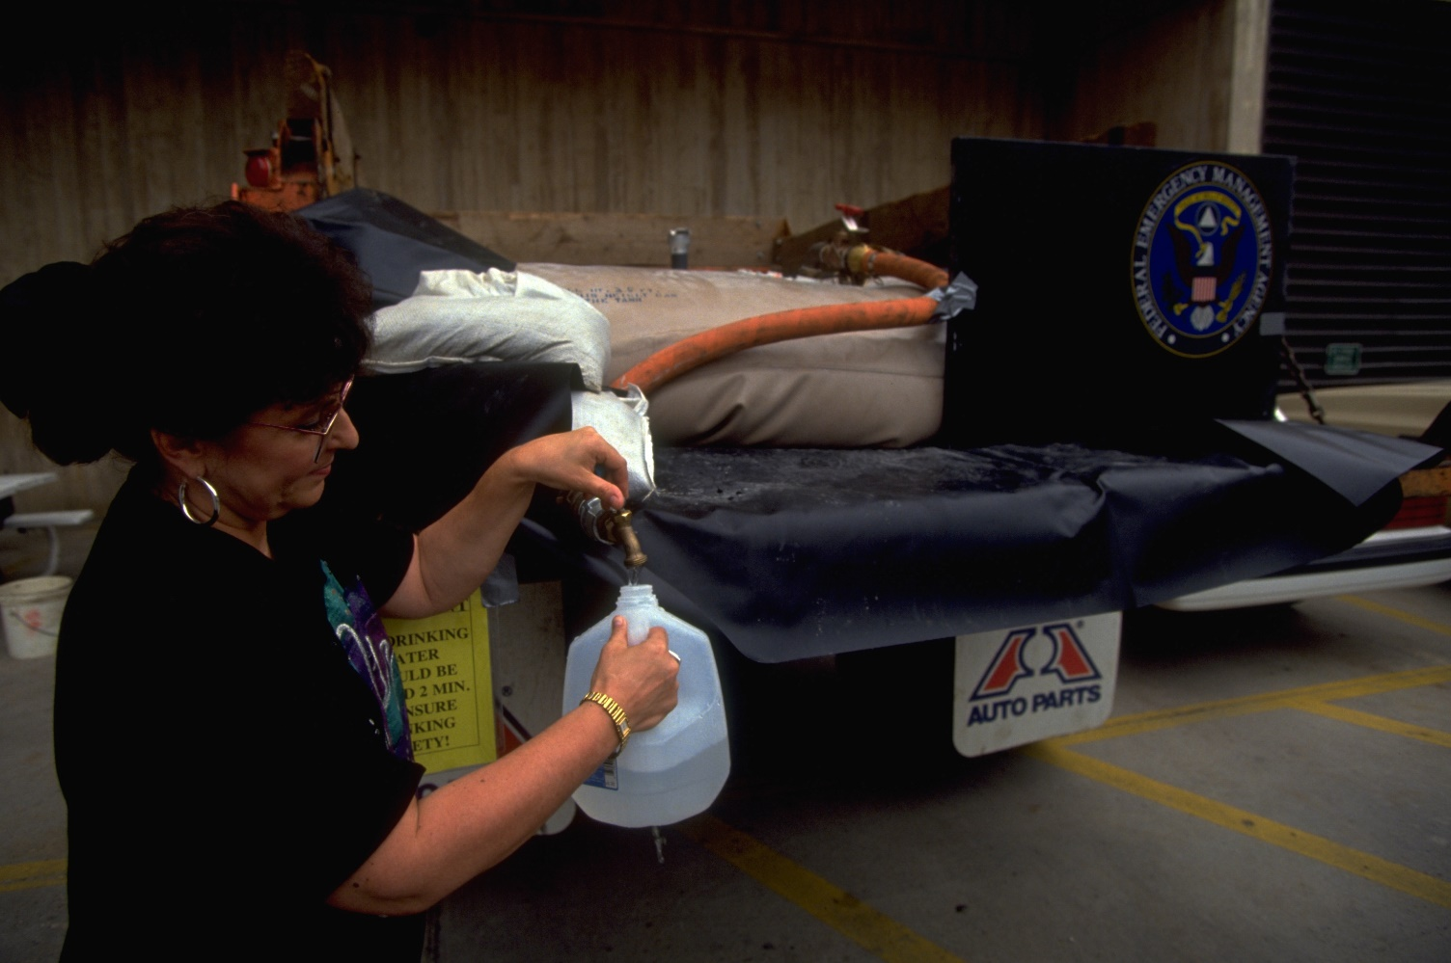
Module 4 – Two Weeks

Slide 23
Key Issues – Module 4
Fuel supplies remain limited
Fuel suppliers continue to prioritize critical customers
Public health agencies are continually adjusting their messaging to the public as conditions change
Cell towers and mobile networks are slowly coming back online, providing limited cell service
Significant portions of the population are leaving the impacted area due to the lack of power and running water
Notes:
Based on the information provided, encourage players to participate in a discussion concerning the issues raised in Module 4. Identify any critical issues, decisions, requirements or questions that should be addressed at this time.
The following questions are provided as suggested subjects that you may wish to address as the discussion progresses. These questions are not meant to constitute a definitive list of concerns to be addressed, nor is there a requirement to address every question.
[Will dual power feeds and pigtail hookups be a viable option for a grid outage of this duration?]
[Is your utility able to obtain fuel for generators from reliable suppliers for a power outage lasting two weeks or longer?]
[What steps may need to be taken to provide critical customers, such as hospitals and other health care facilities, with water and wastewater services?]
[What are the minimum acceptable levels of water and wastewater service during a prolonged power outage?]
[Are there any other outside agencies that water utilities may need to coordinate with?]
[Are drinking water utilities willing to keep their system pressurized with water that does not meet Safe Drinking Water Act requirements?]
[Will the primacy agency support this strategy?]
[Would a boil notice suffice in this situation? If not, what notification would be made?]
[While this strategy may help with firefighting and basic sanitation, what impacts will this have on water system critical customers such as hospitals or large commercial users?]
[Are there lasting impacts to the utility or any of its users that should be considered?]
[Could some services zones be “turned off” in favor of other service zones?]
[How important is it for emergency management to avoid a mass migration outside of the affected area?]
[Are wastewater utilities willing to bypass all or portions of their treatment processes and discharge wastewater that does not meet Clean Water Act requirements?]
[Will the primacy agency support this strategy?]
[Are there lasting ramifications to the environment or the wastewater utility that have to be considered?]
[Have you considered and coordinated with drinking water plants that have downstream water intakes that might not be treating water prior to distribution?]
[How will water and wastewater services be provided to hospitals and health care facilities that are in no power zones?]

Slide 24
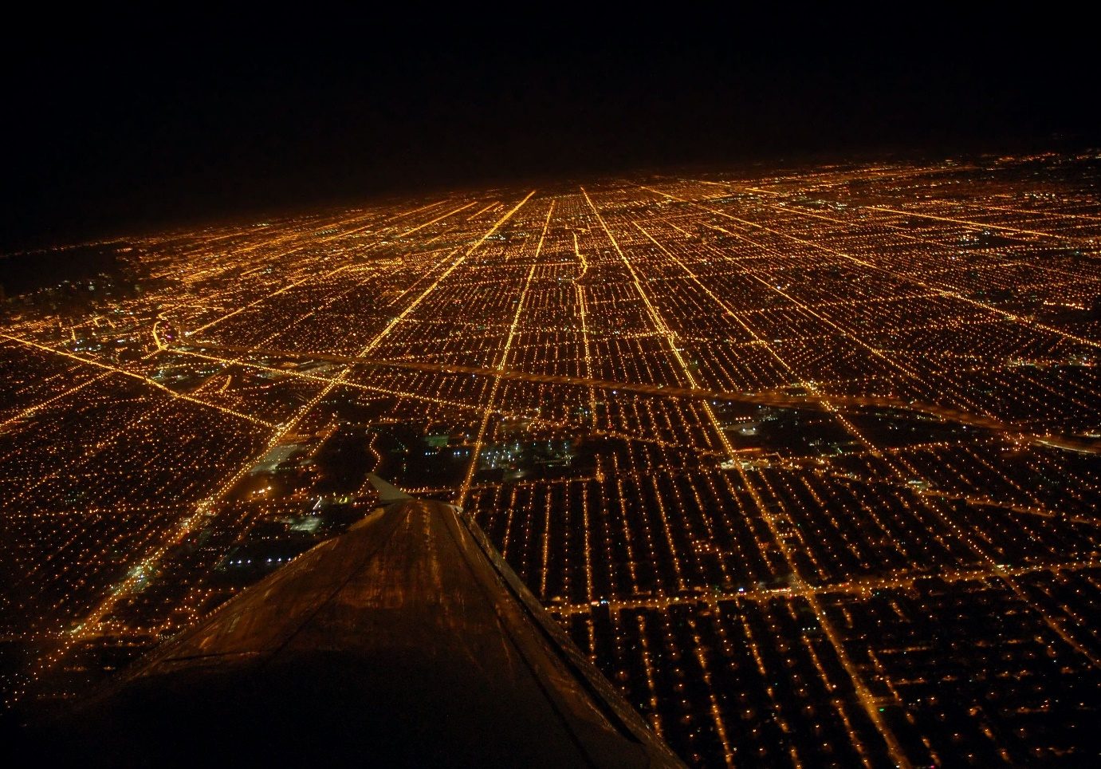
Module 5 – Recovery

Slide 25
Key Issues – Module 5
Power is restored
The media and the public are asking when water service will be restored and safe for all uses
Members of the public that left the impacted area begin to return, creating increased demand for water and power
Water utilities are testing water throughout their systems to ensure that it is safe to drink
Notes:
Based on the information provided, encourage players to participate in a discussion concerning the issues raised in Module 5. Identify any critical issues, decisions, requirements or questions that should be addressed at this time.
The following questions are provided as suggested subjects that you may wish to address as the discussion progresses. These questions are not meant to constitute a definitive list of concerns to be addressed, nor is there a requirement to address every question.
[Does your utility have procedures for taking facilities off generator power and returning to grid power?]
[Does your utility prioritize operations for power restoration and coordinate with your power provider to ensure that these priorities are understood, addressed, and synchronized?]
[Do you coordinate with your power provider to minimize disruptive starts/stops when resuming normal operations?]
[Does your utility have a sampling and analysis plan for assessing safety of treated water?]
[What are your utility’s notification procedures for providing information to customers, response partners, and employees when power is restored?]
[What is your utility’s procedure for maintaining and repairing generators and replenishing fuel supplies?]
[How will your utility conduct damage assessment and document costs to apply for state and federal disaster funding?]
[What are your utility’s procedures for conducting an after-action assessment of its response and capturing lessons learned to update plans and procedures (e.g., risk assessment, emergency response plan and business continuity plan?]
[Are public health agencies coordinating with water utilities regarding messaging to the public as zones within the system are cleared for use?]
[What is your messaging to the public regarding safely resuming use of tap water (i.e., drinking, cooking, washing, bathing)?]
[Will you need to recommend procedures to flush household water prior to resuming normal use?]
[What are the procedures for advising health care providers about safely resuming use of treated water?]
[Would the EMA conduct a post-incident hotwash with utilities, state and federal agencies and other key stakeholders to assess the effectiveness of procedures and communications plans used during the response?]

Slide 26
Action planning session post exercise
Action Planning Session
Post-Exercise “Hot Wash”

Slide 27
Review of exercise objectives
Review of Exercise Objectives
Define or refine participants’ roles and responsibilities for managing the consequences of a black sky incident, which should be reflected in their plans, policies and procedures and other preparedness elements currently in place or under development
Build relationships between utilities and stakeholders
Determine neighboring utility water infrastructure capabilities and needs
Identify other needed enhancements related to training and exercises and other preparedness elements currently in place or under development
Notes:
Discuss each objective and corresponding outcome.

Slide 28
conclusion
Conclusion
Please turn in your notes from the Action Planning Session, your participant evaluation form and any additional comments you wish to share
This information will be used to develop an After Action Report and Improvement Plan

Slide 29
Closing remarks thank you for participating
Closing Remarks
Thank you for participating

